Slide 1
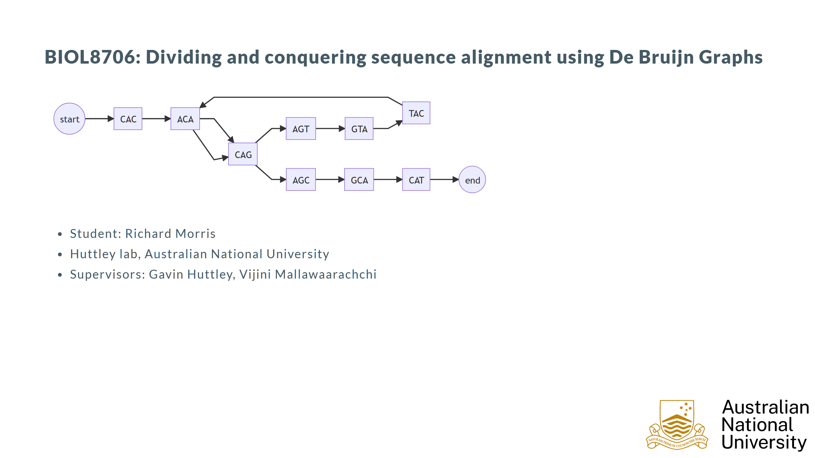

Slide 2
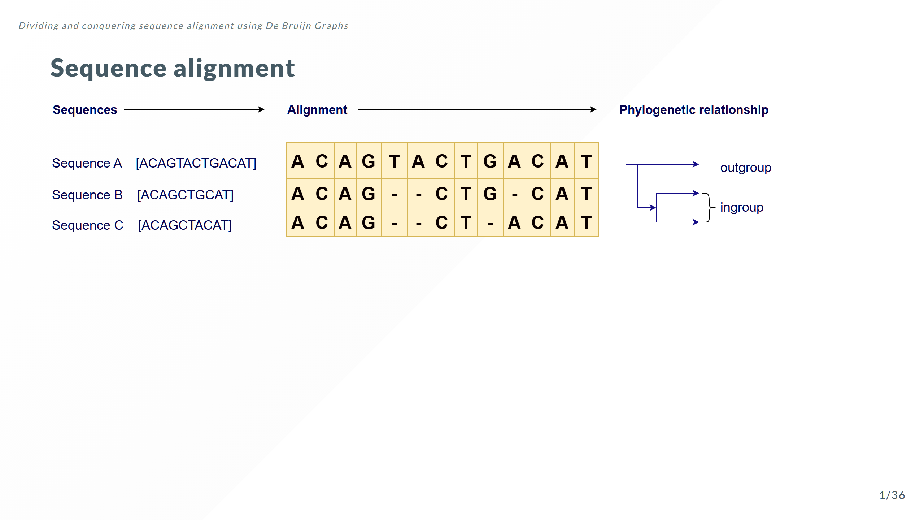

Slide 3
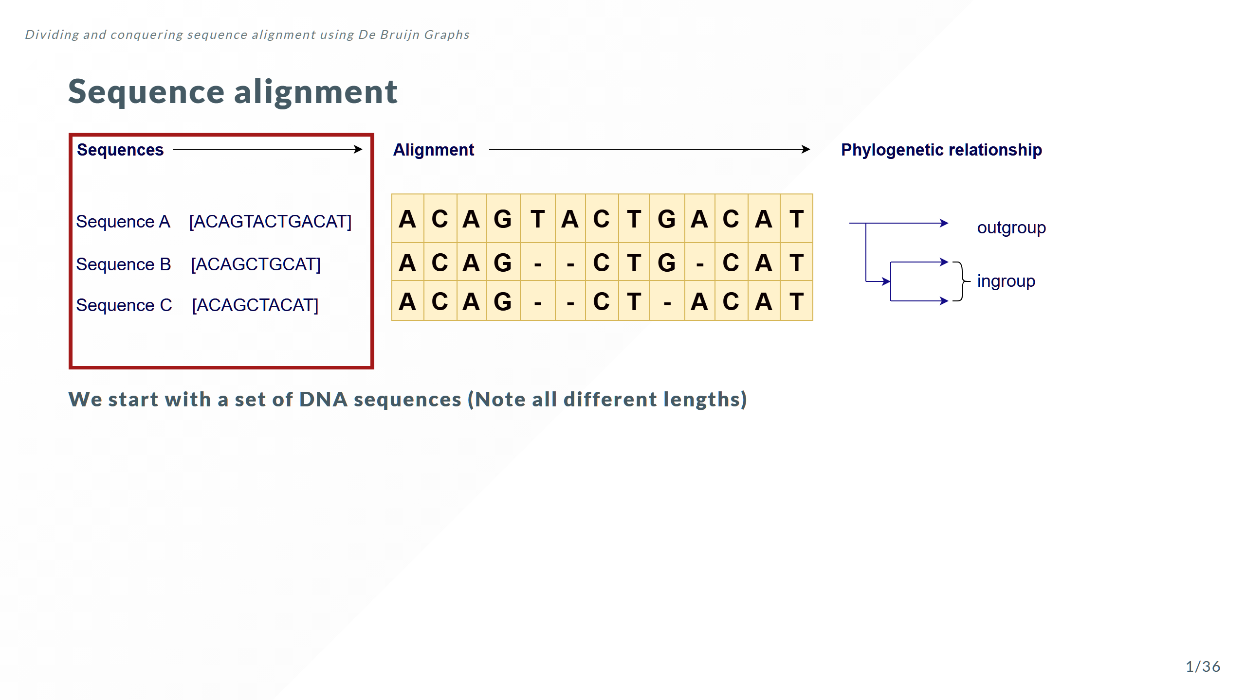

Slide 4
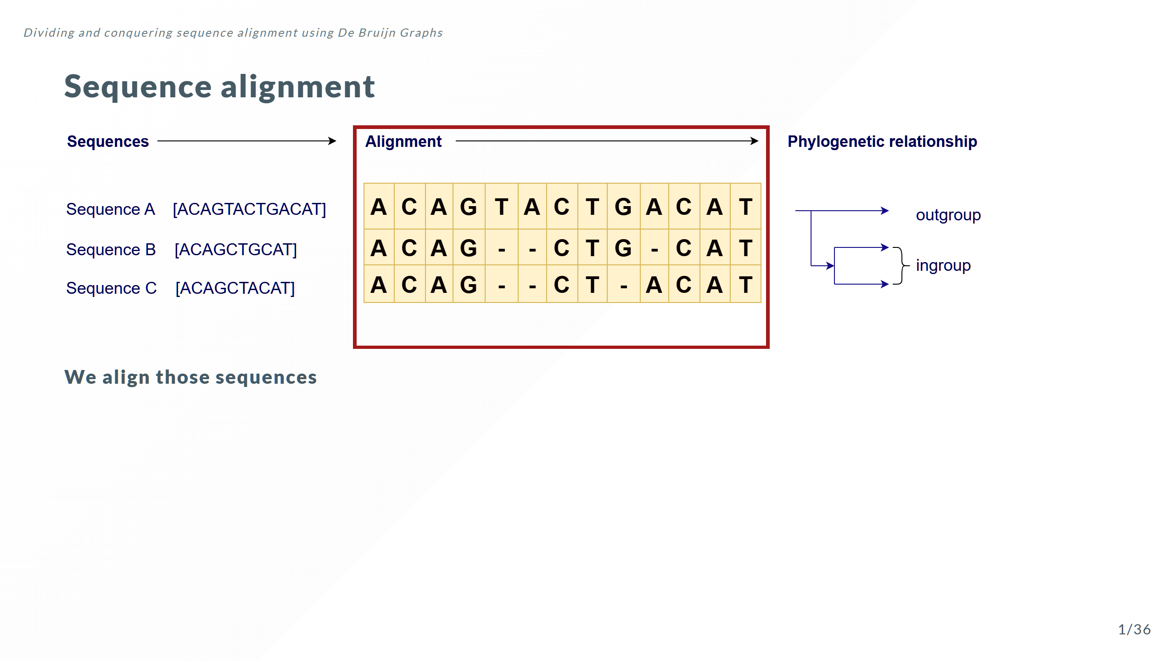

Slide 5
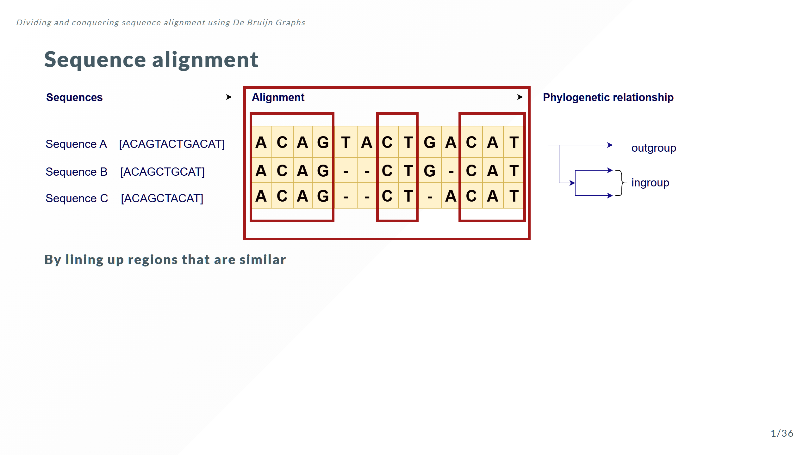

Slide 6
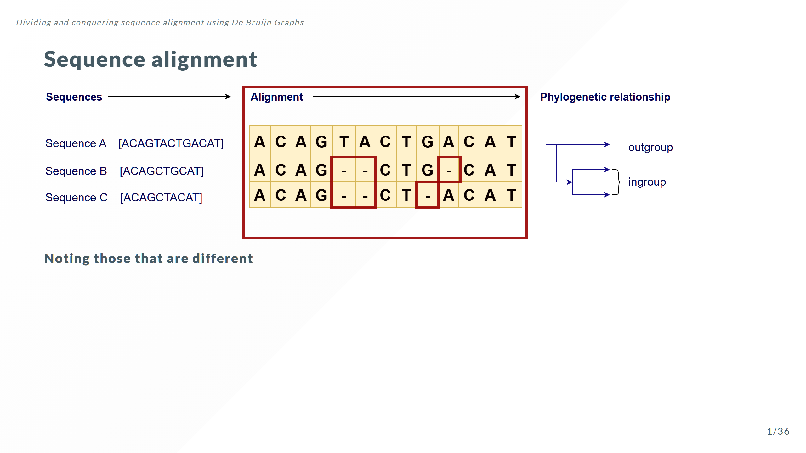

Slide 7
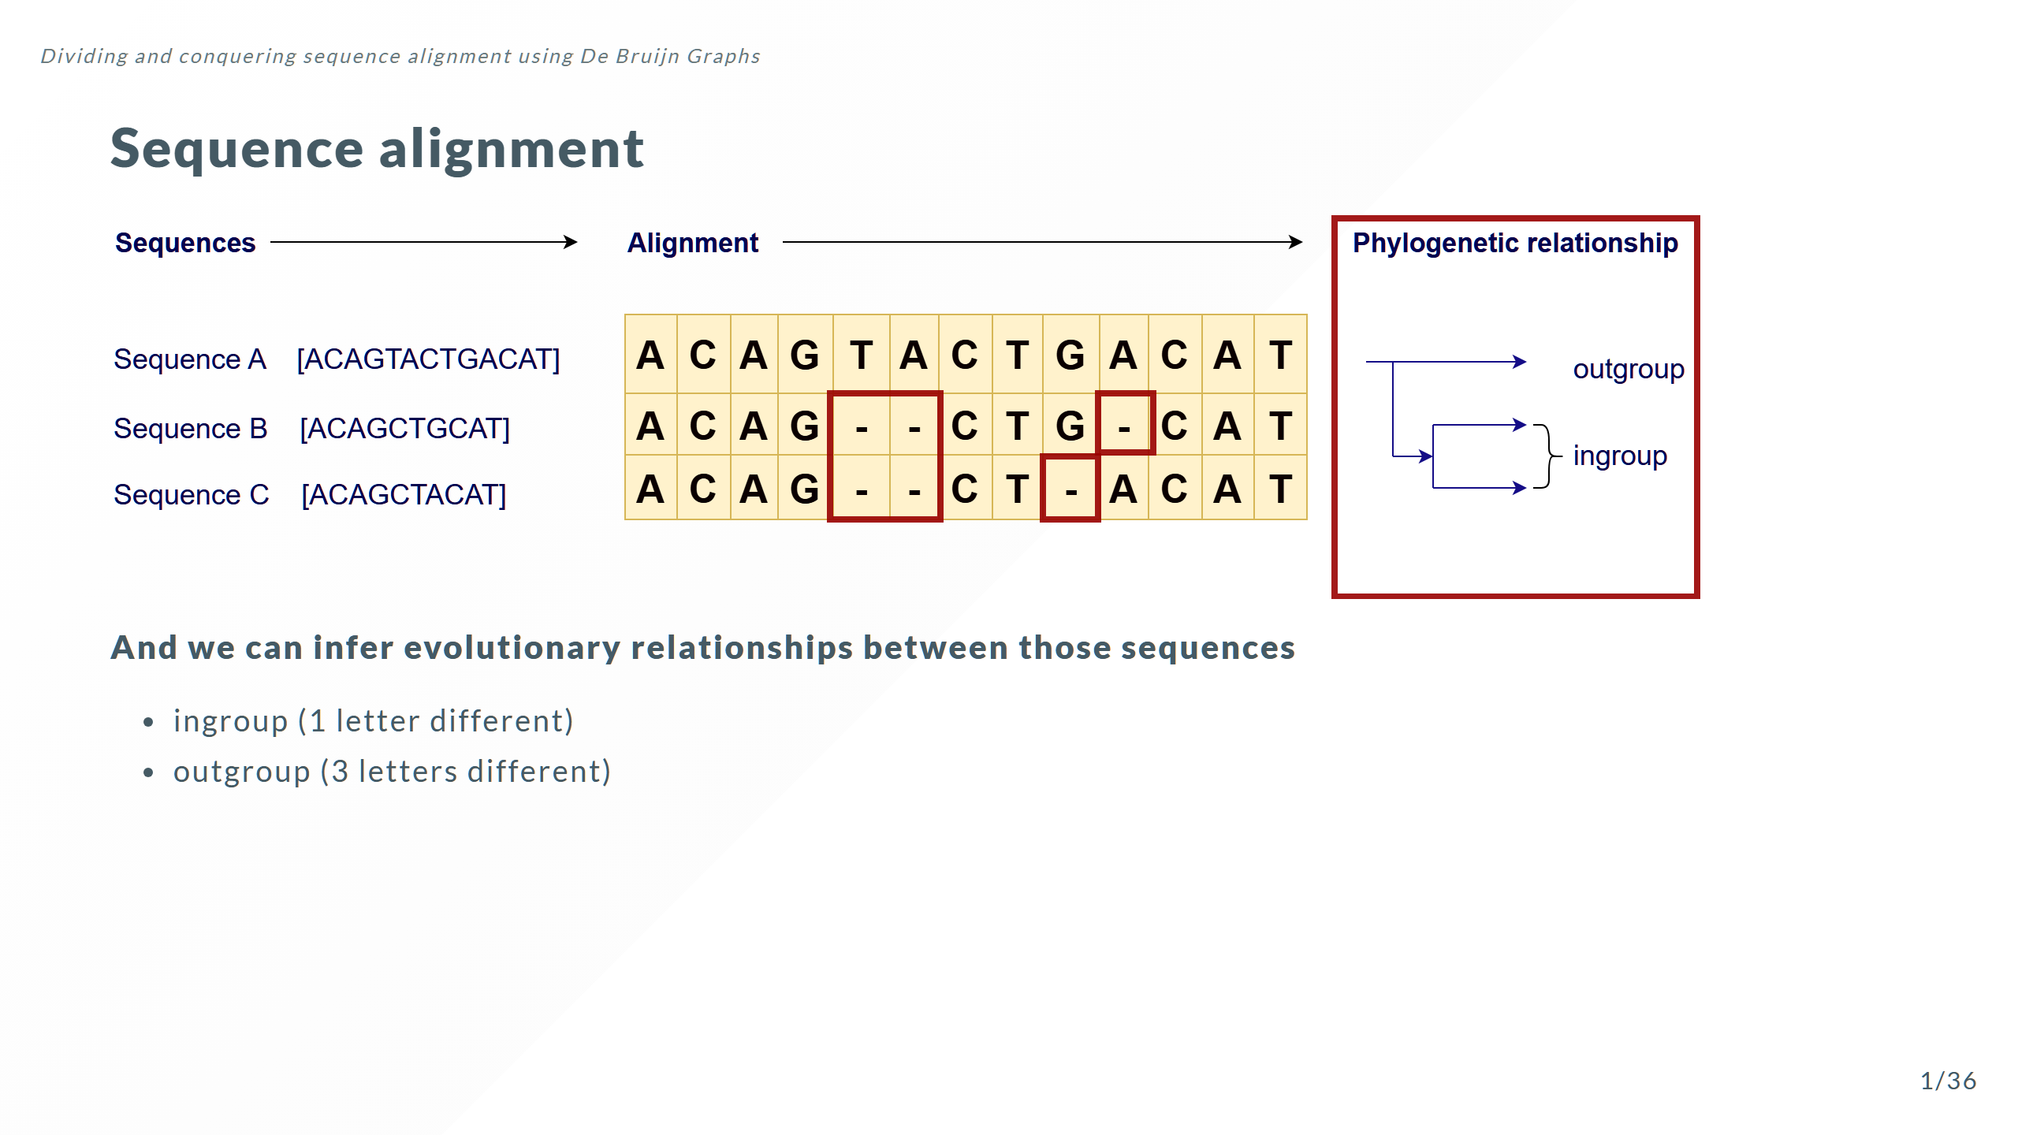

Slide 8
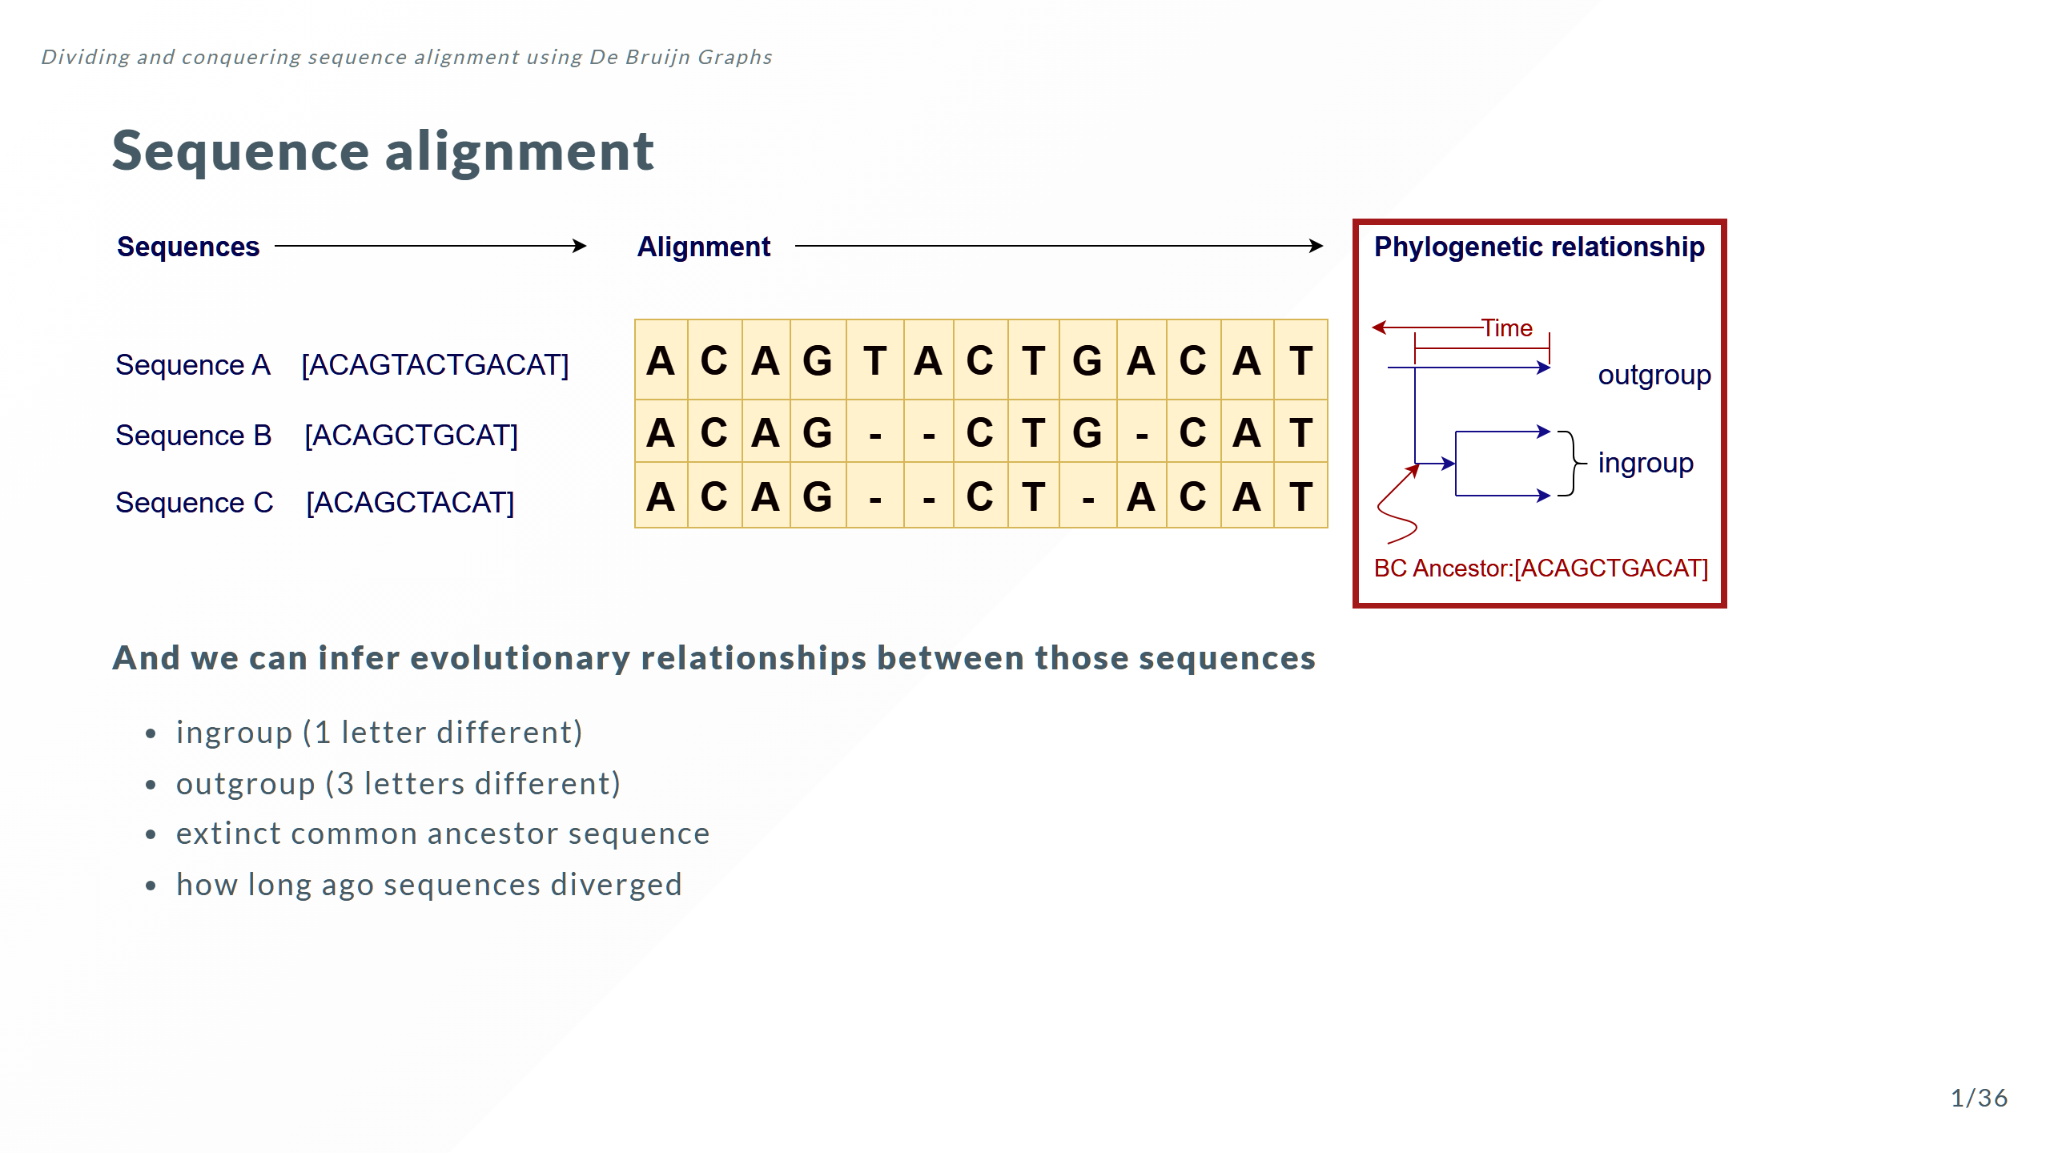

Slide 9
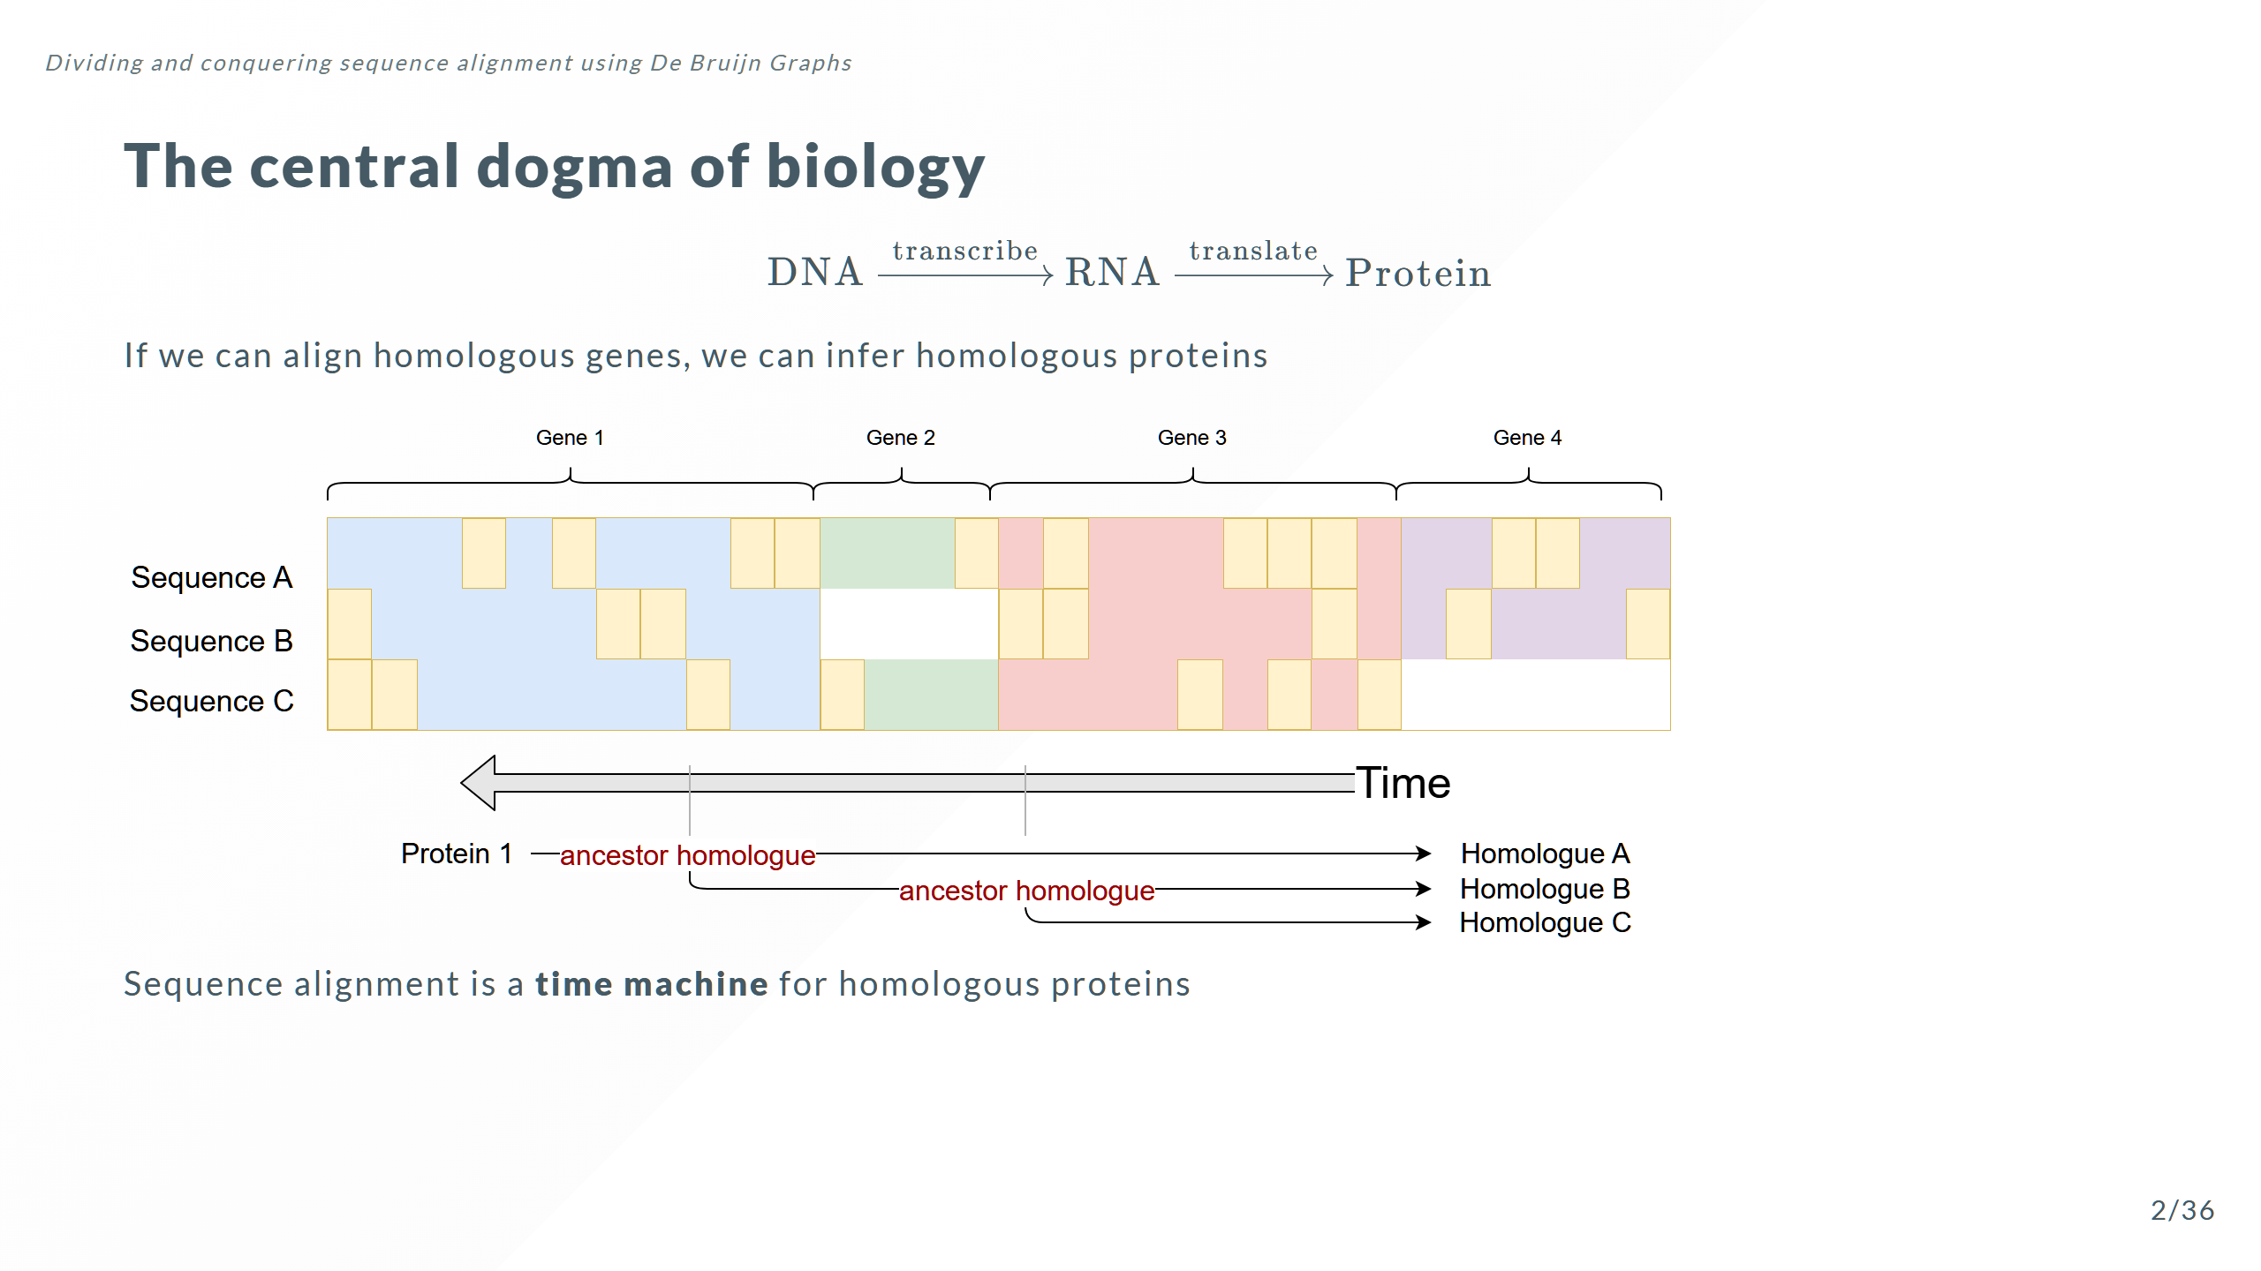

Slide 10
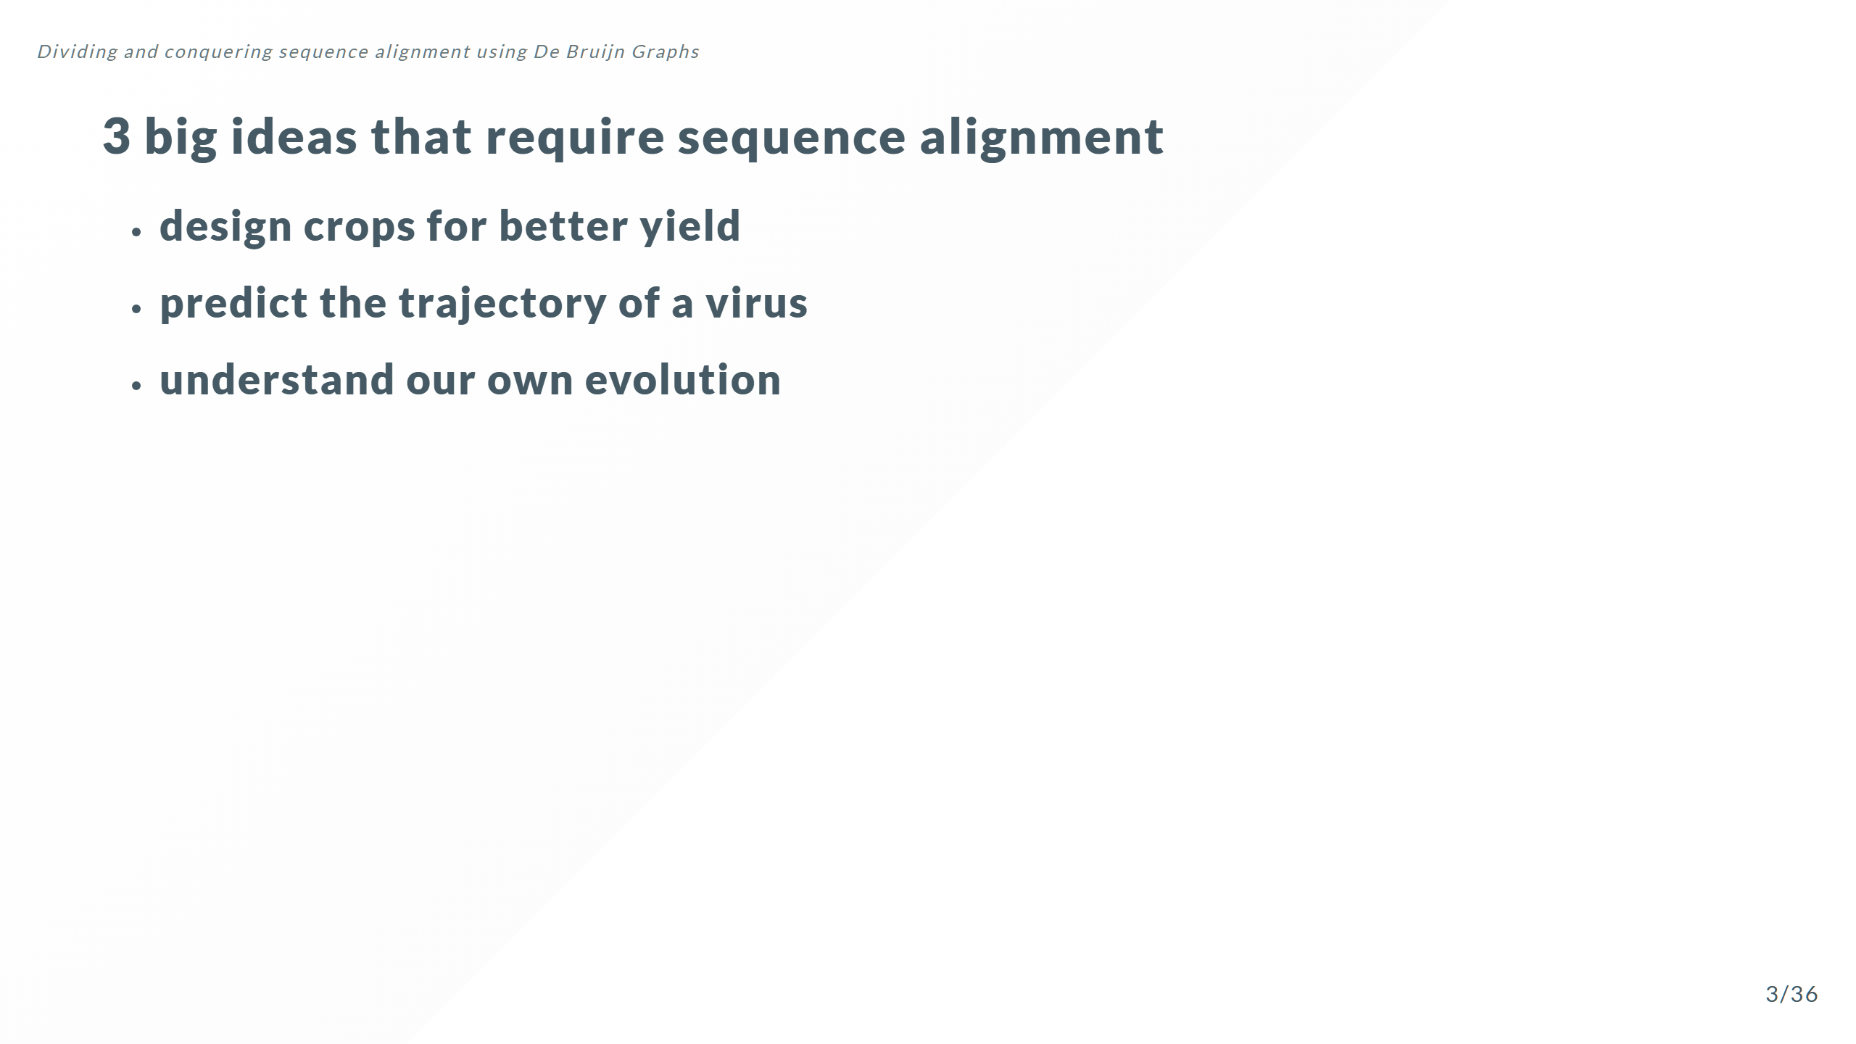

Slide 11
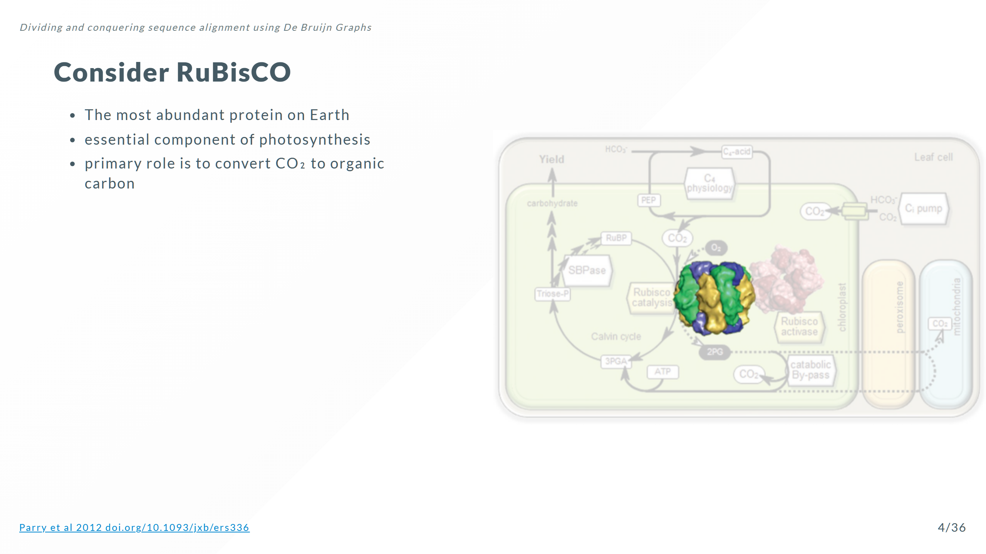

Slide 12
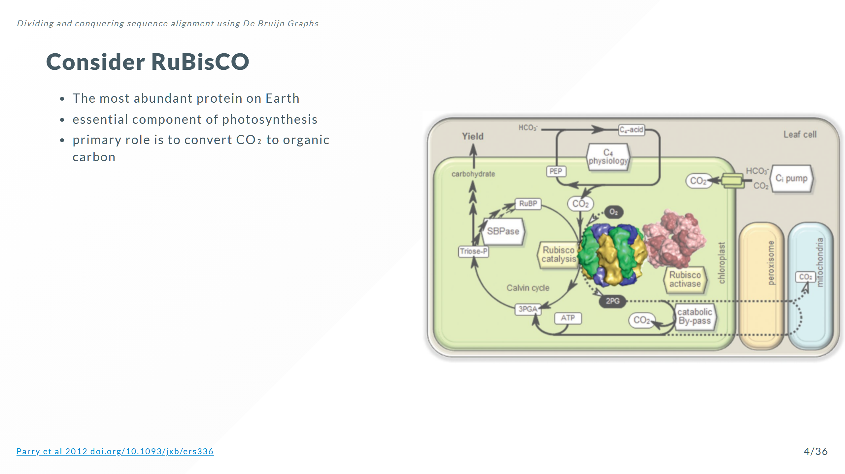

Slide 13
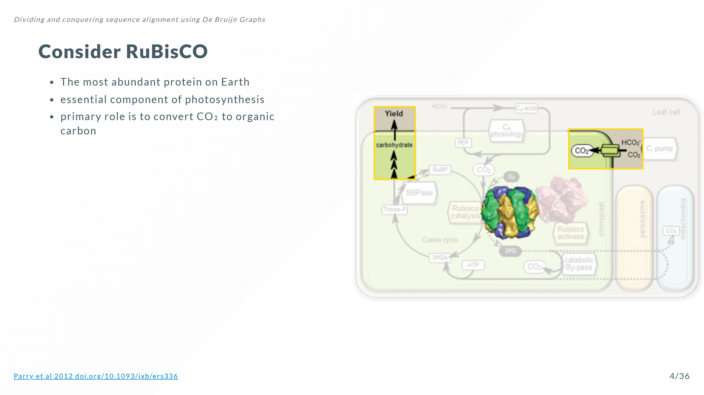

Slide 14
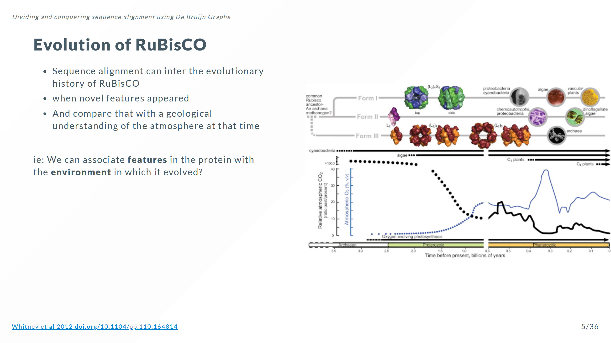
Notes:
This will tell us important things like RuBisCO innovations for different partial pressures of O₂ and CO₂

Slide 15
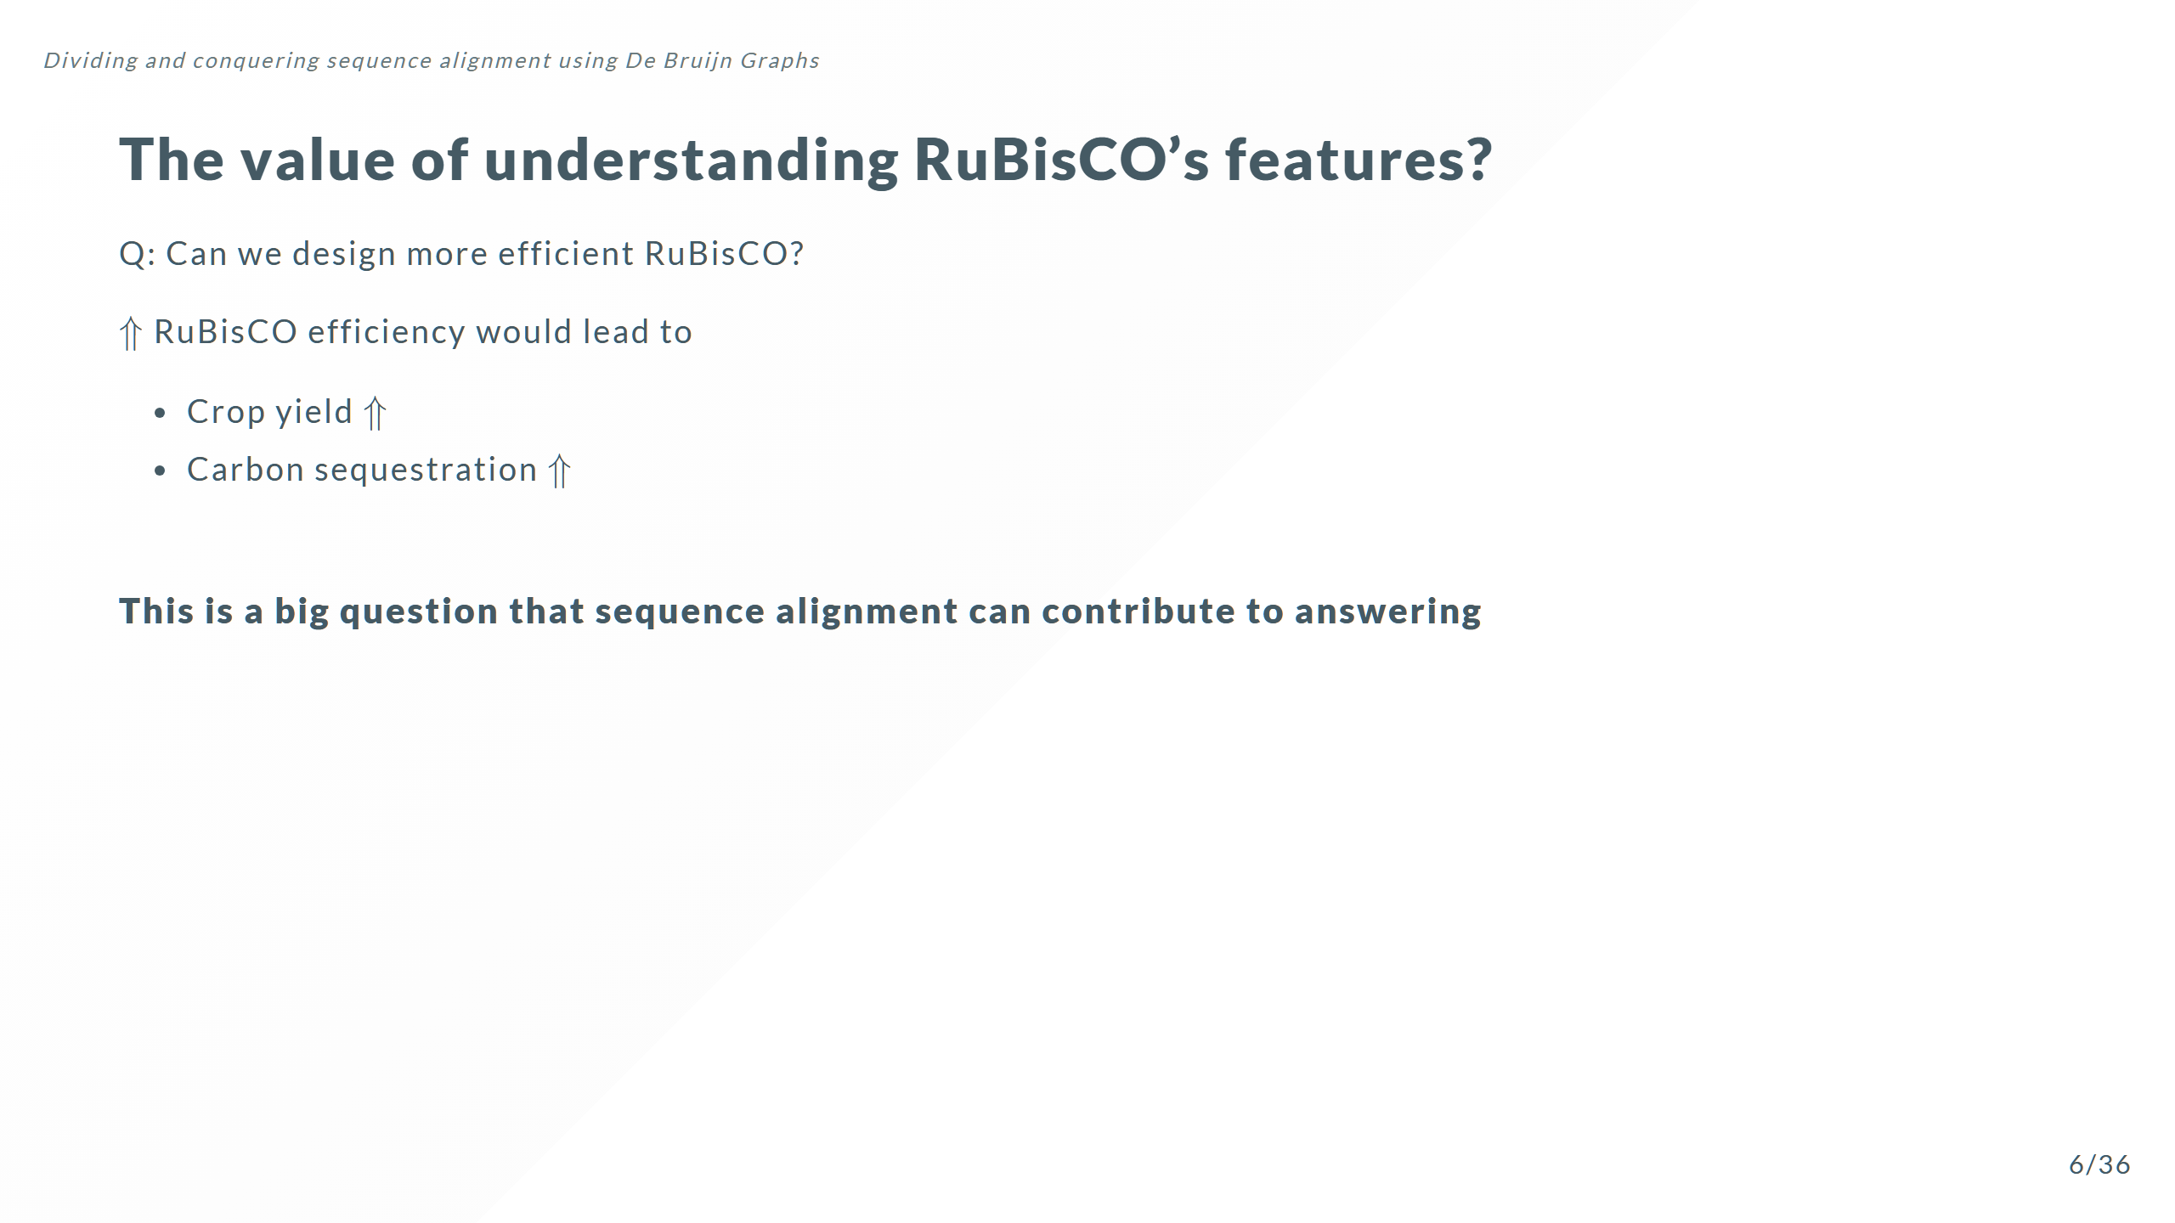
Notes:
RuBisCO processes ~3-10 CO₂ molecules per second Contrast with ATP Synthase which generates 100-200 molecules of ATP per second Can we engineer organisms that spend less time making RuBisCO, and more into extracting CO₂ from the atmosphere and making **carbohydrates** or **hydrocarbons**

Slide 16
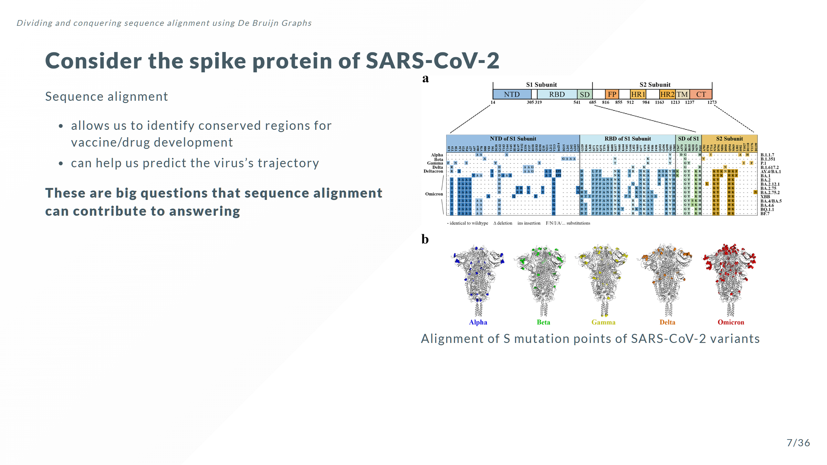

Slide 17
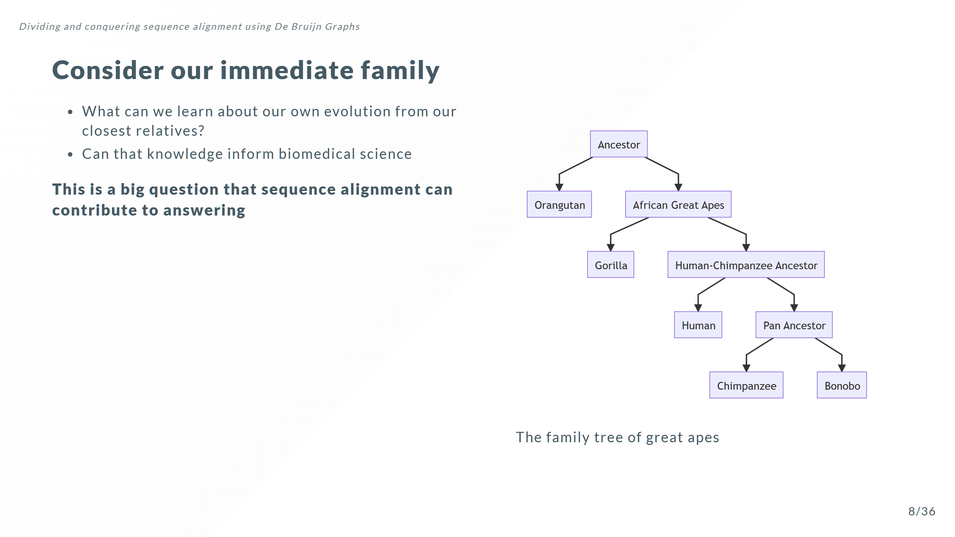

Slide 18
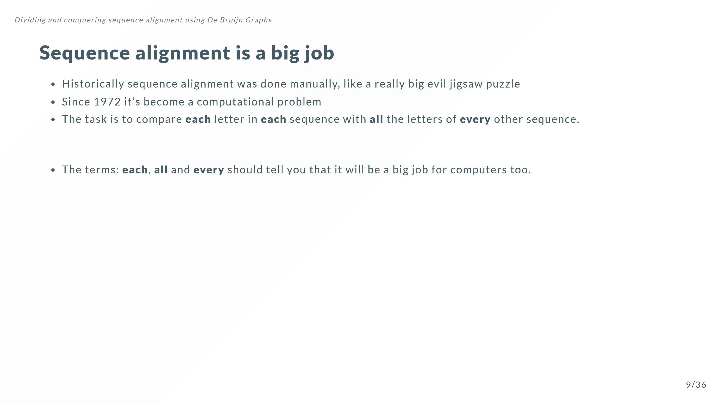

Slide 19
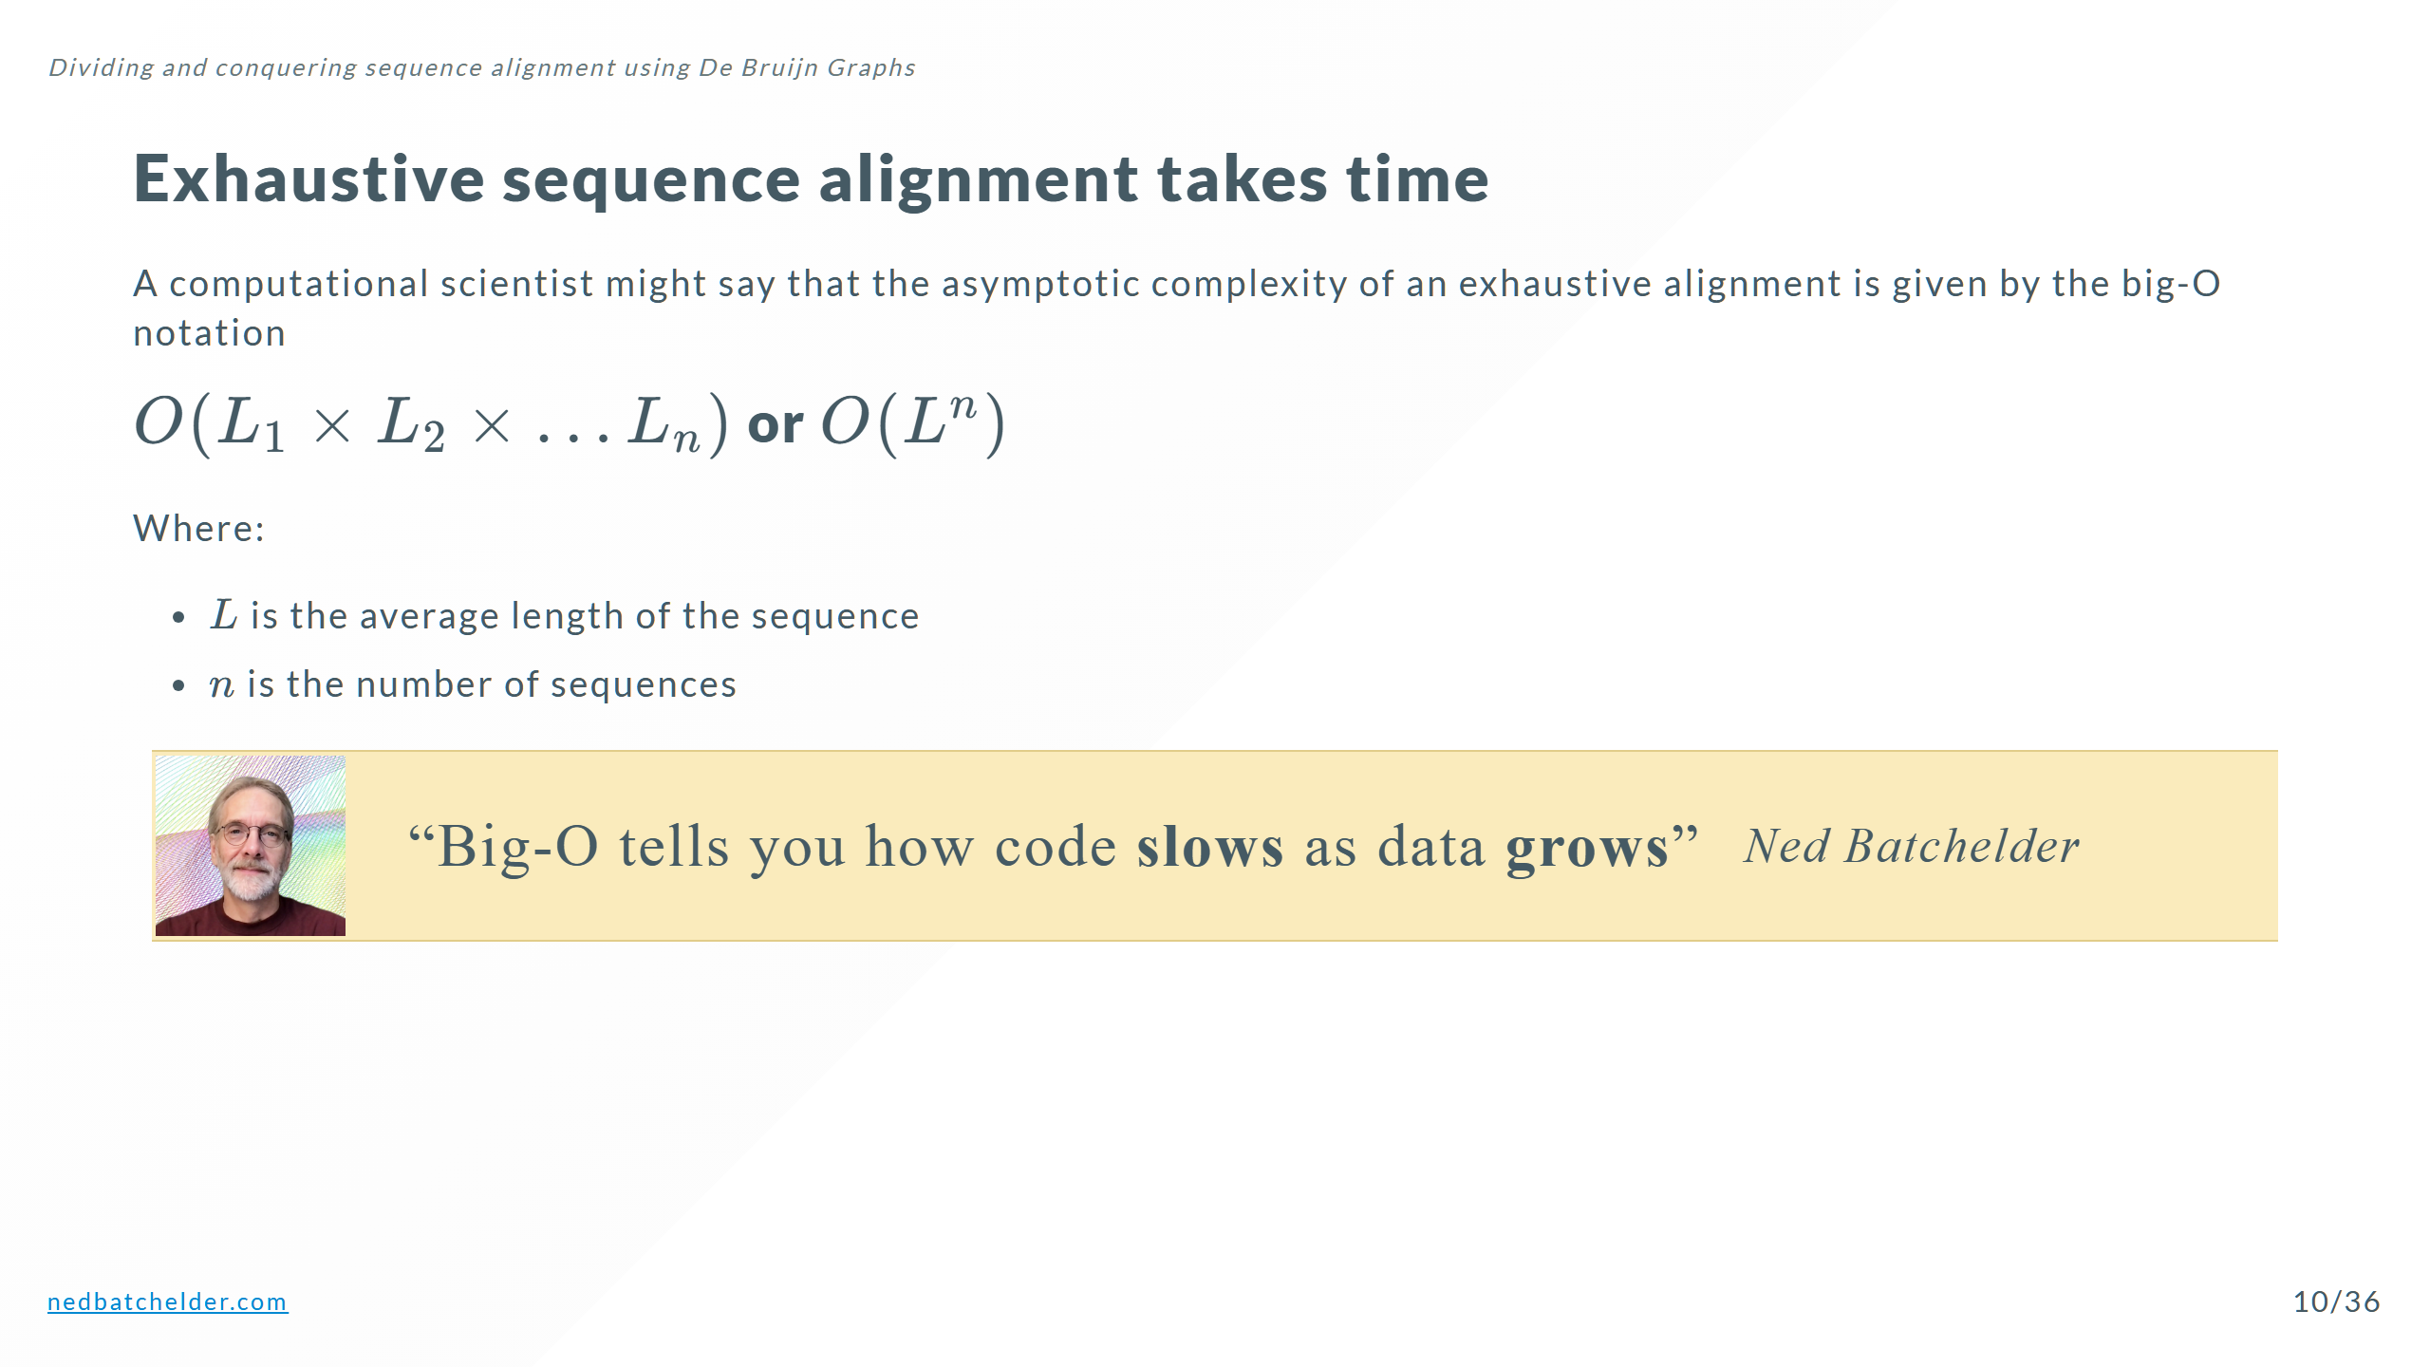

Slide 20
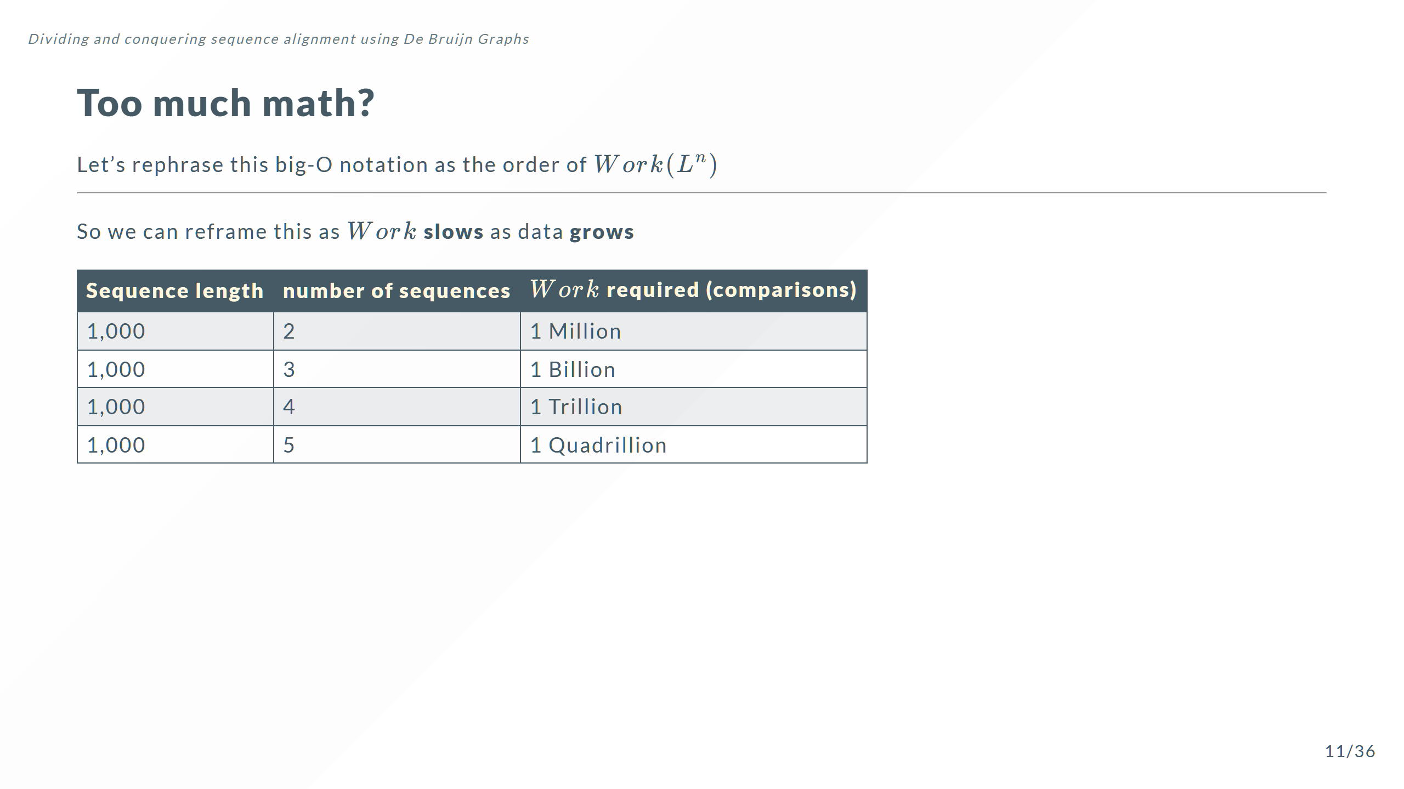

Slide 21


Slide 22
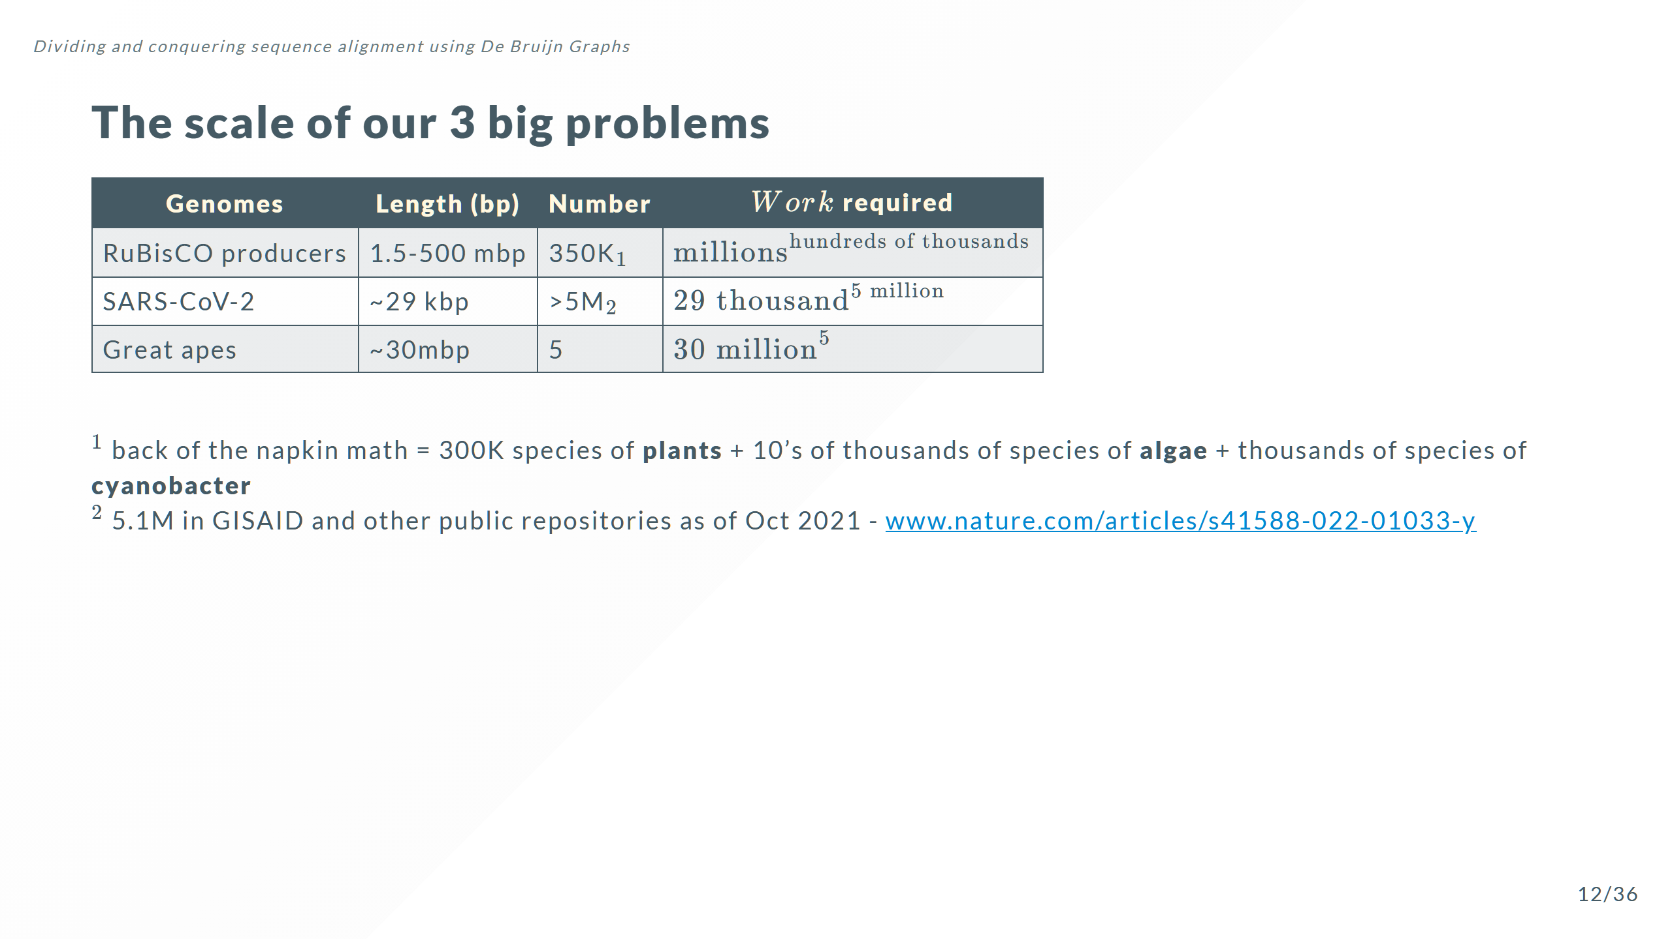
Notes:
Note: The genes that produce the 2 subunits of RuBisCO are ~1500 and ~500 bp respectively but the genomes of species that can make RuBisCO can be 1.5 - 500 mbp long we need to align the entire sequence to find where RuBisCO is being passed down the lineage

Slide 23


Slide 24
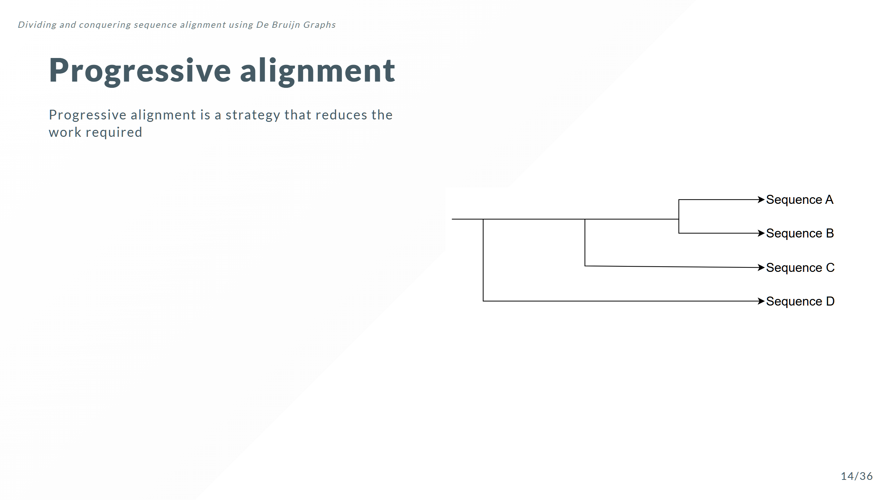

Slide 25
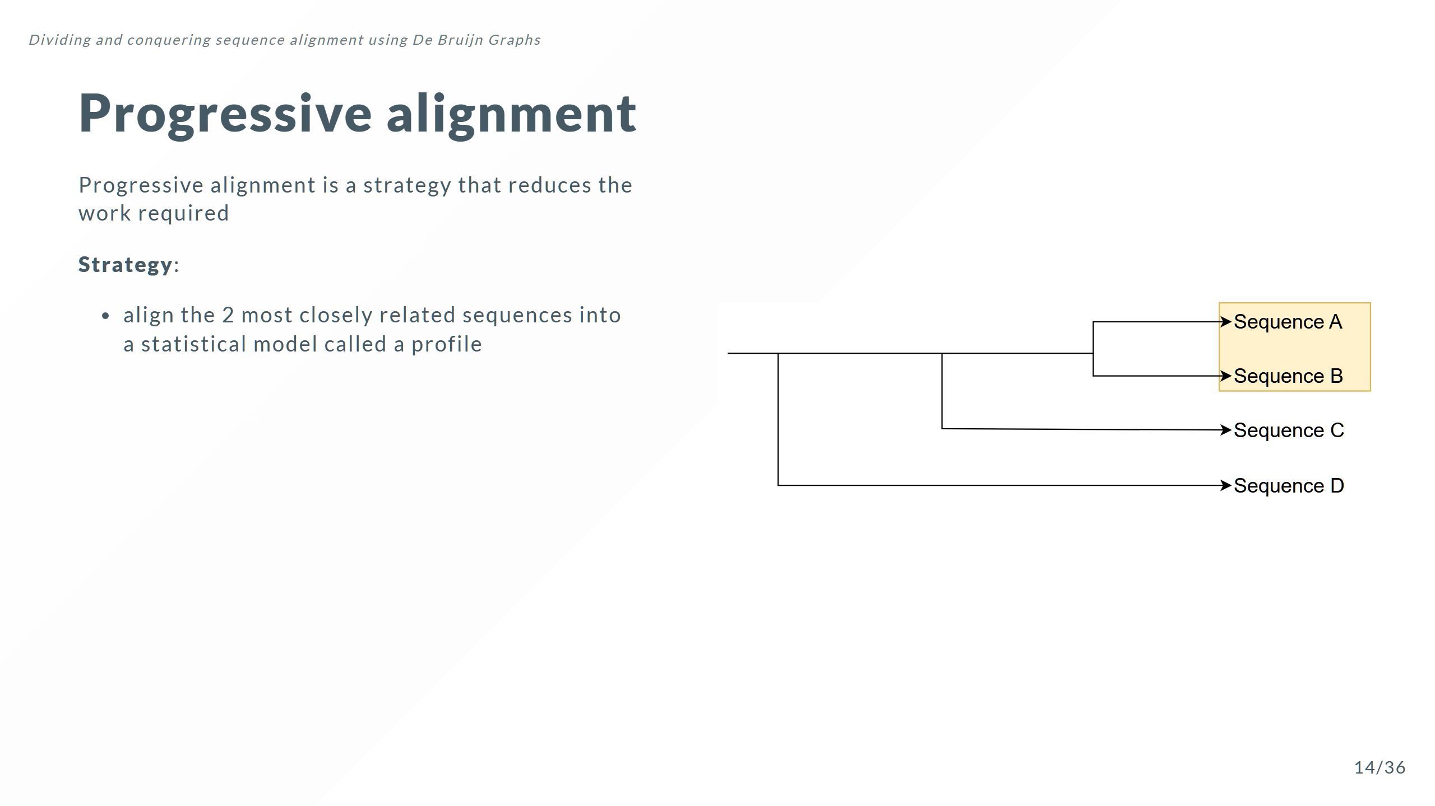

Slide 26
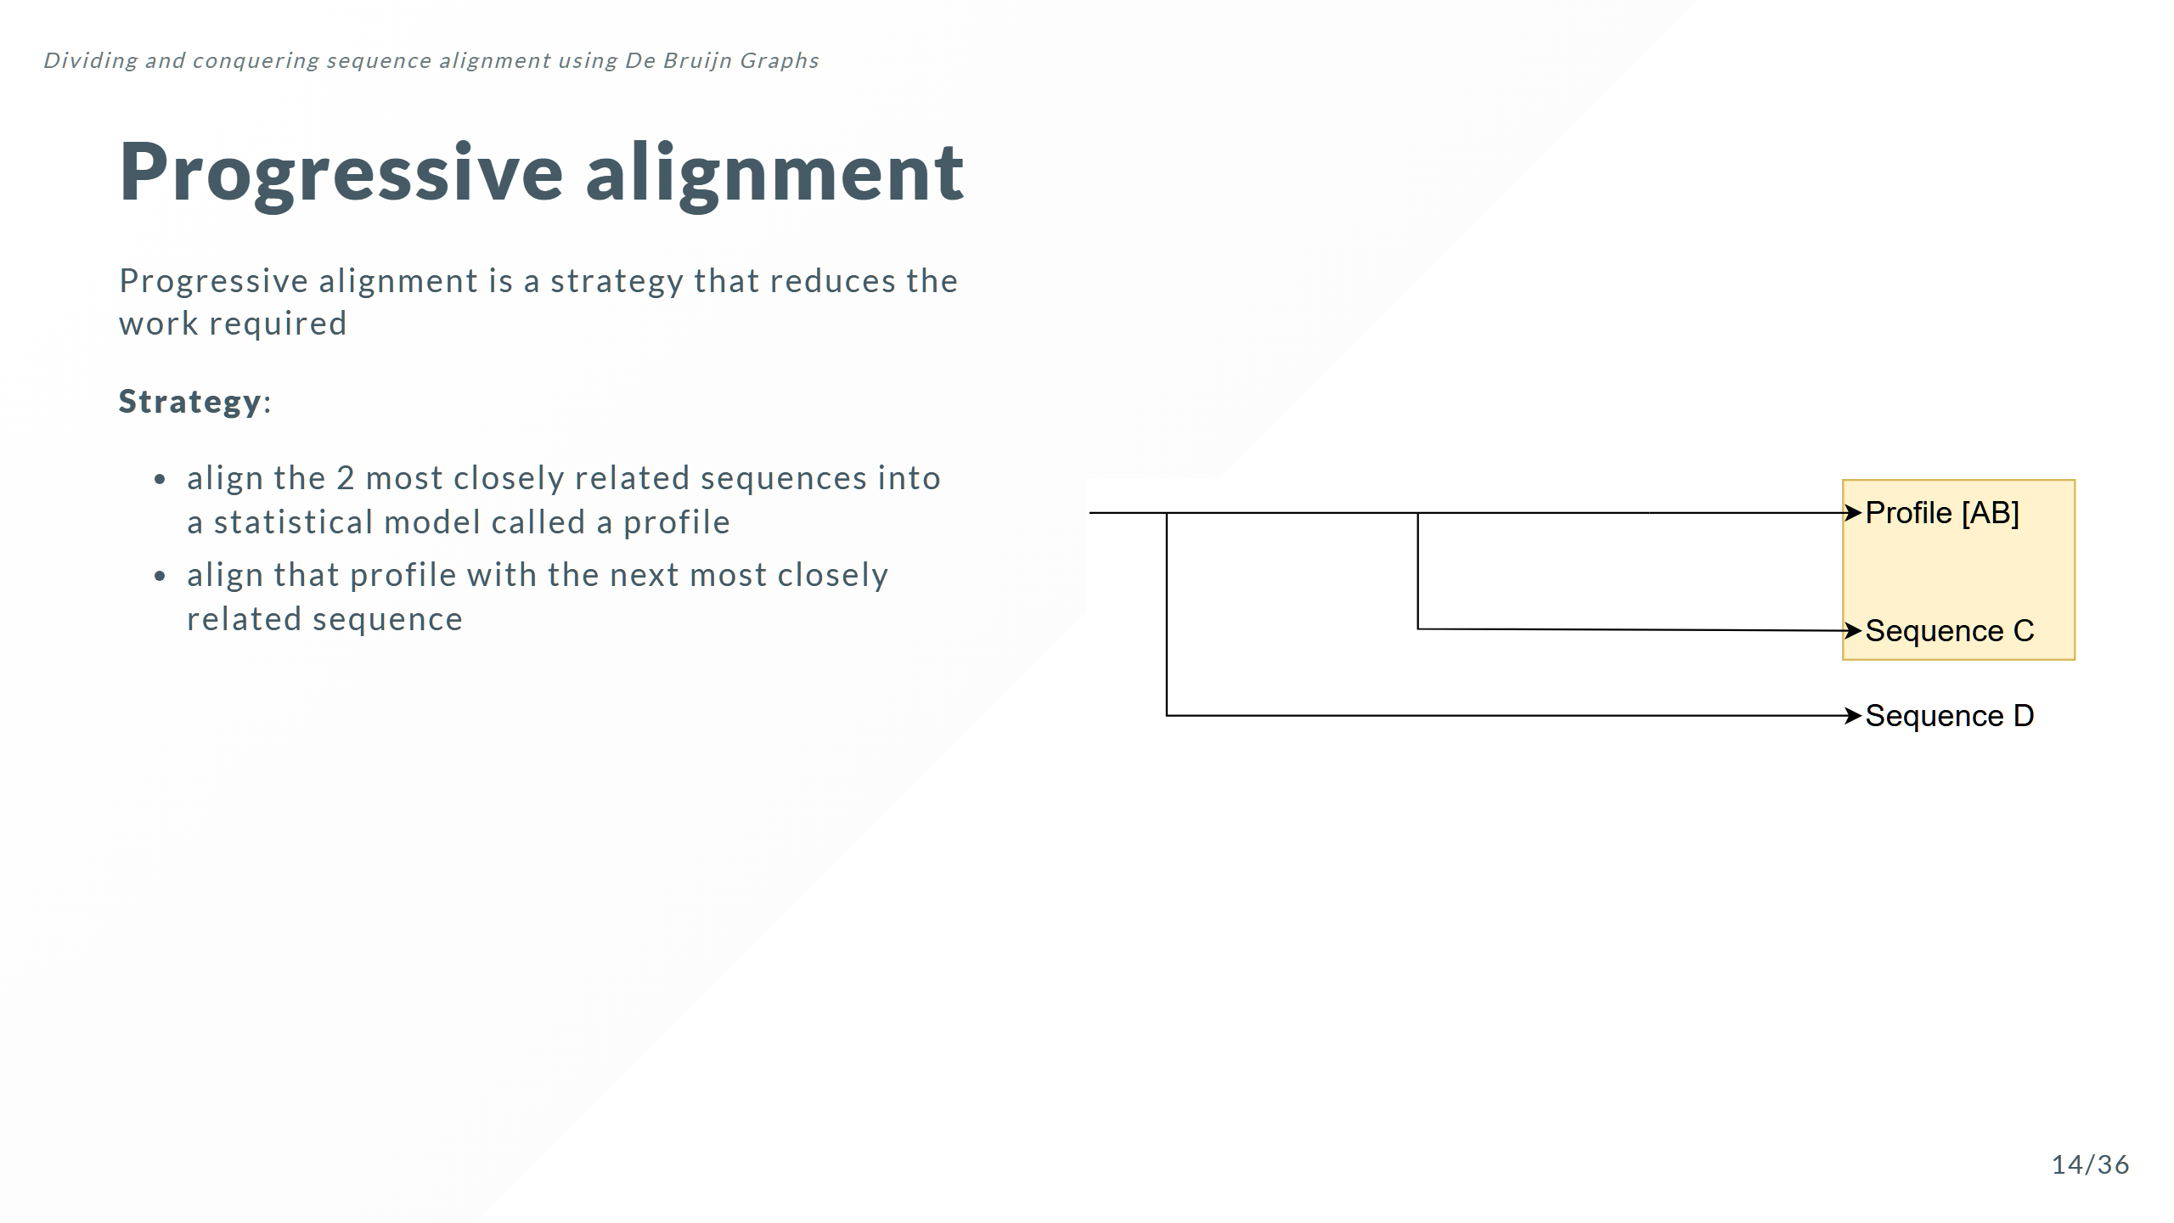

Slide 27
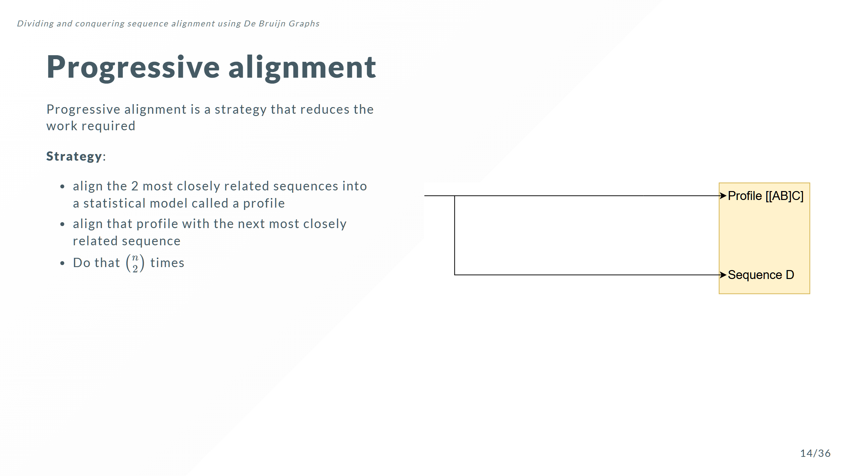

Slide 28
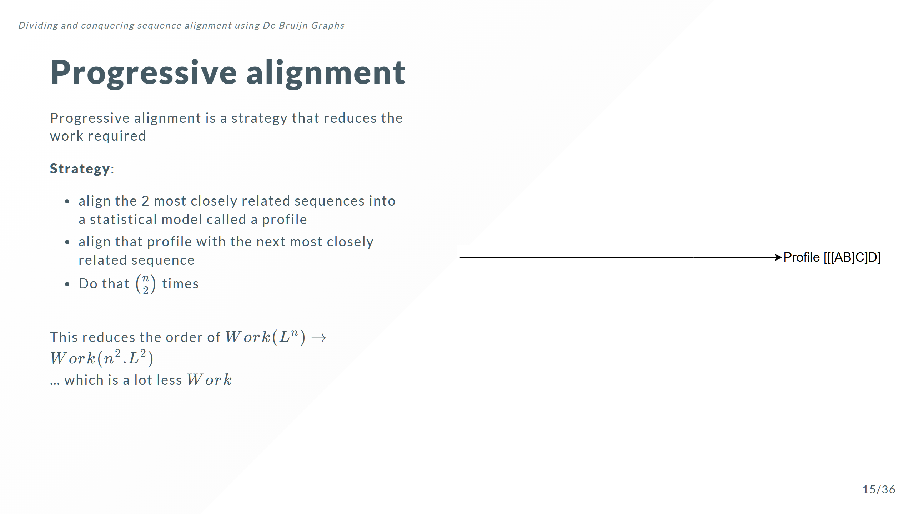
Notes:
$Work$ grows just logarithmically with the number of sequences, rather than exponentially

Slide 29
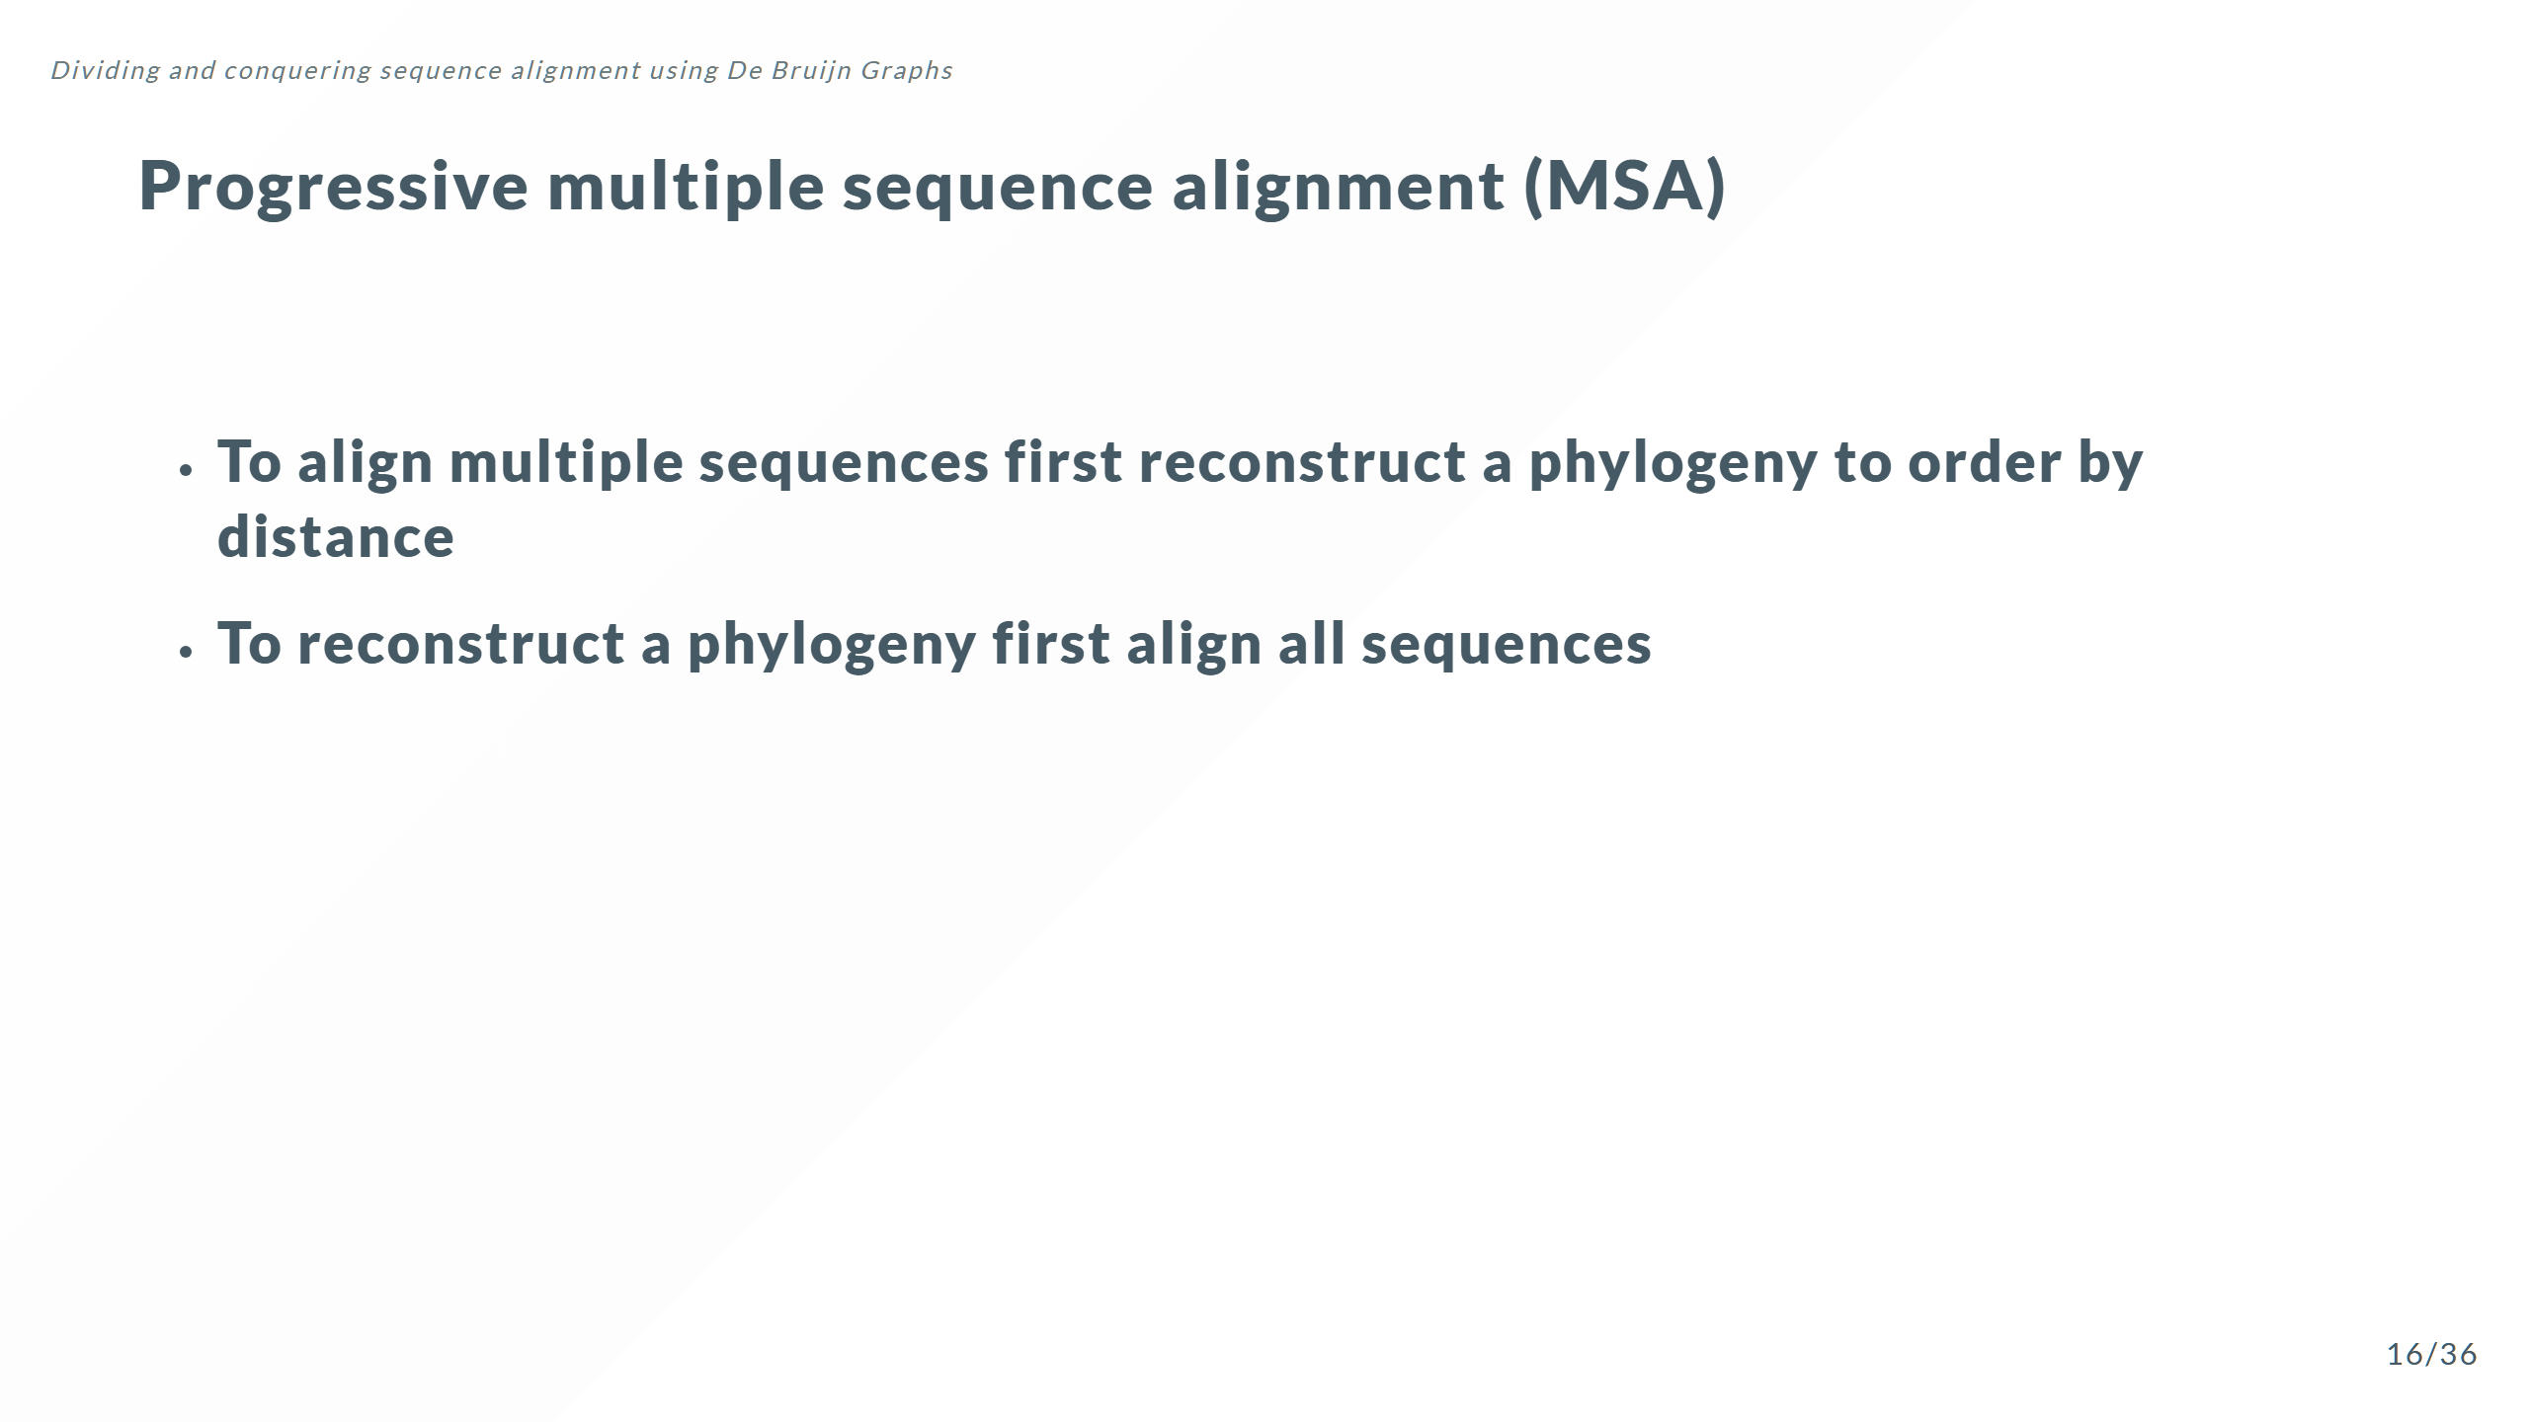

Slide 30
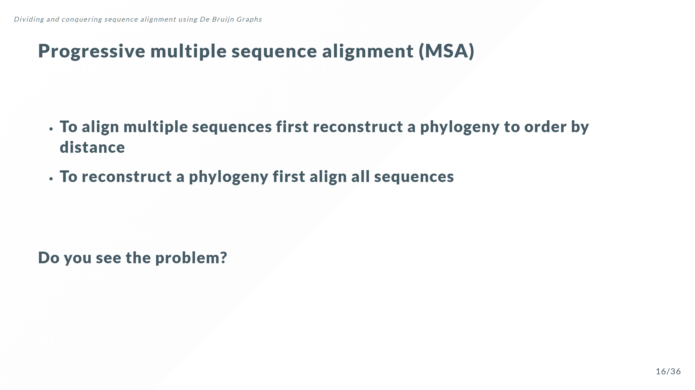

Slide 31
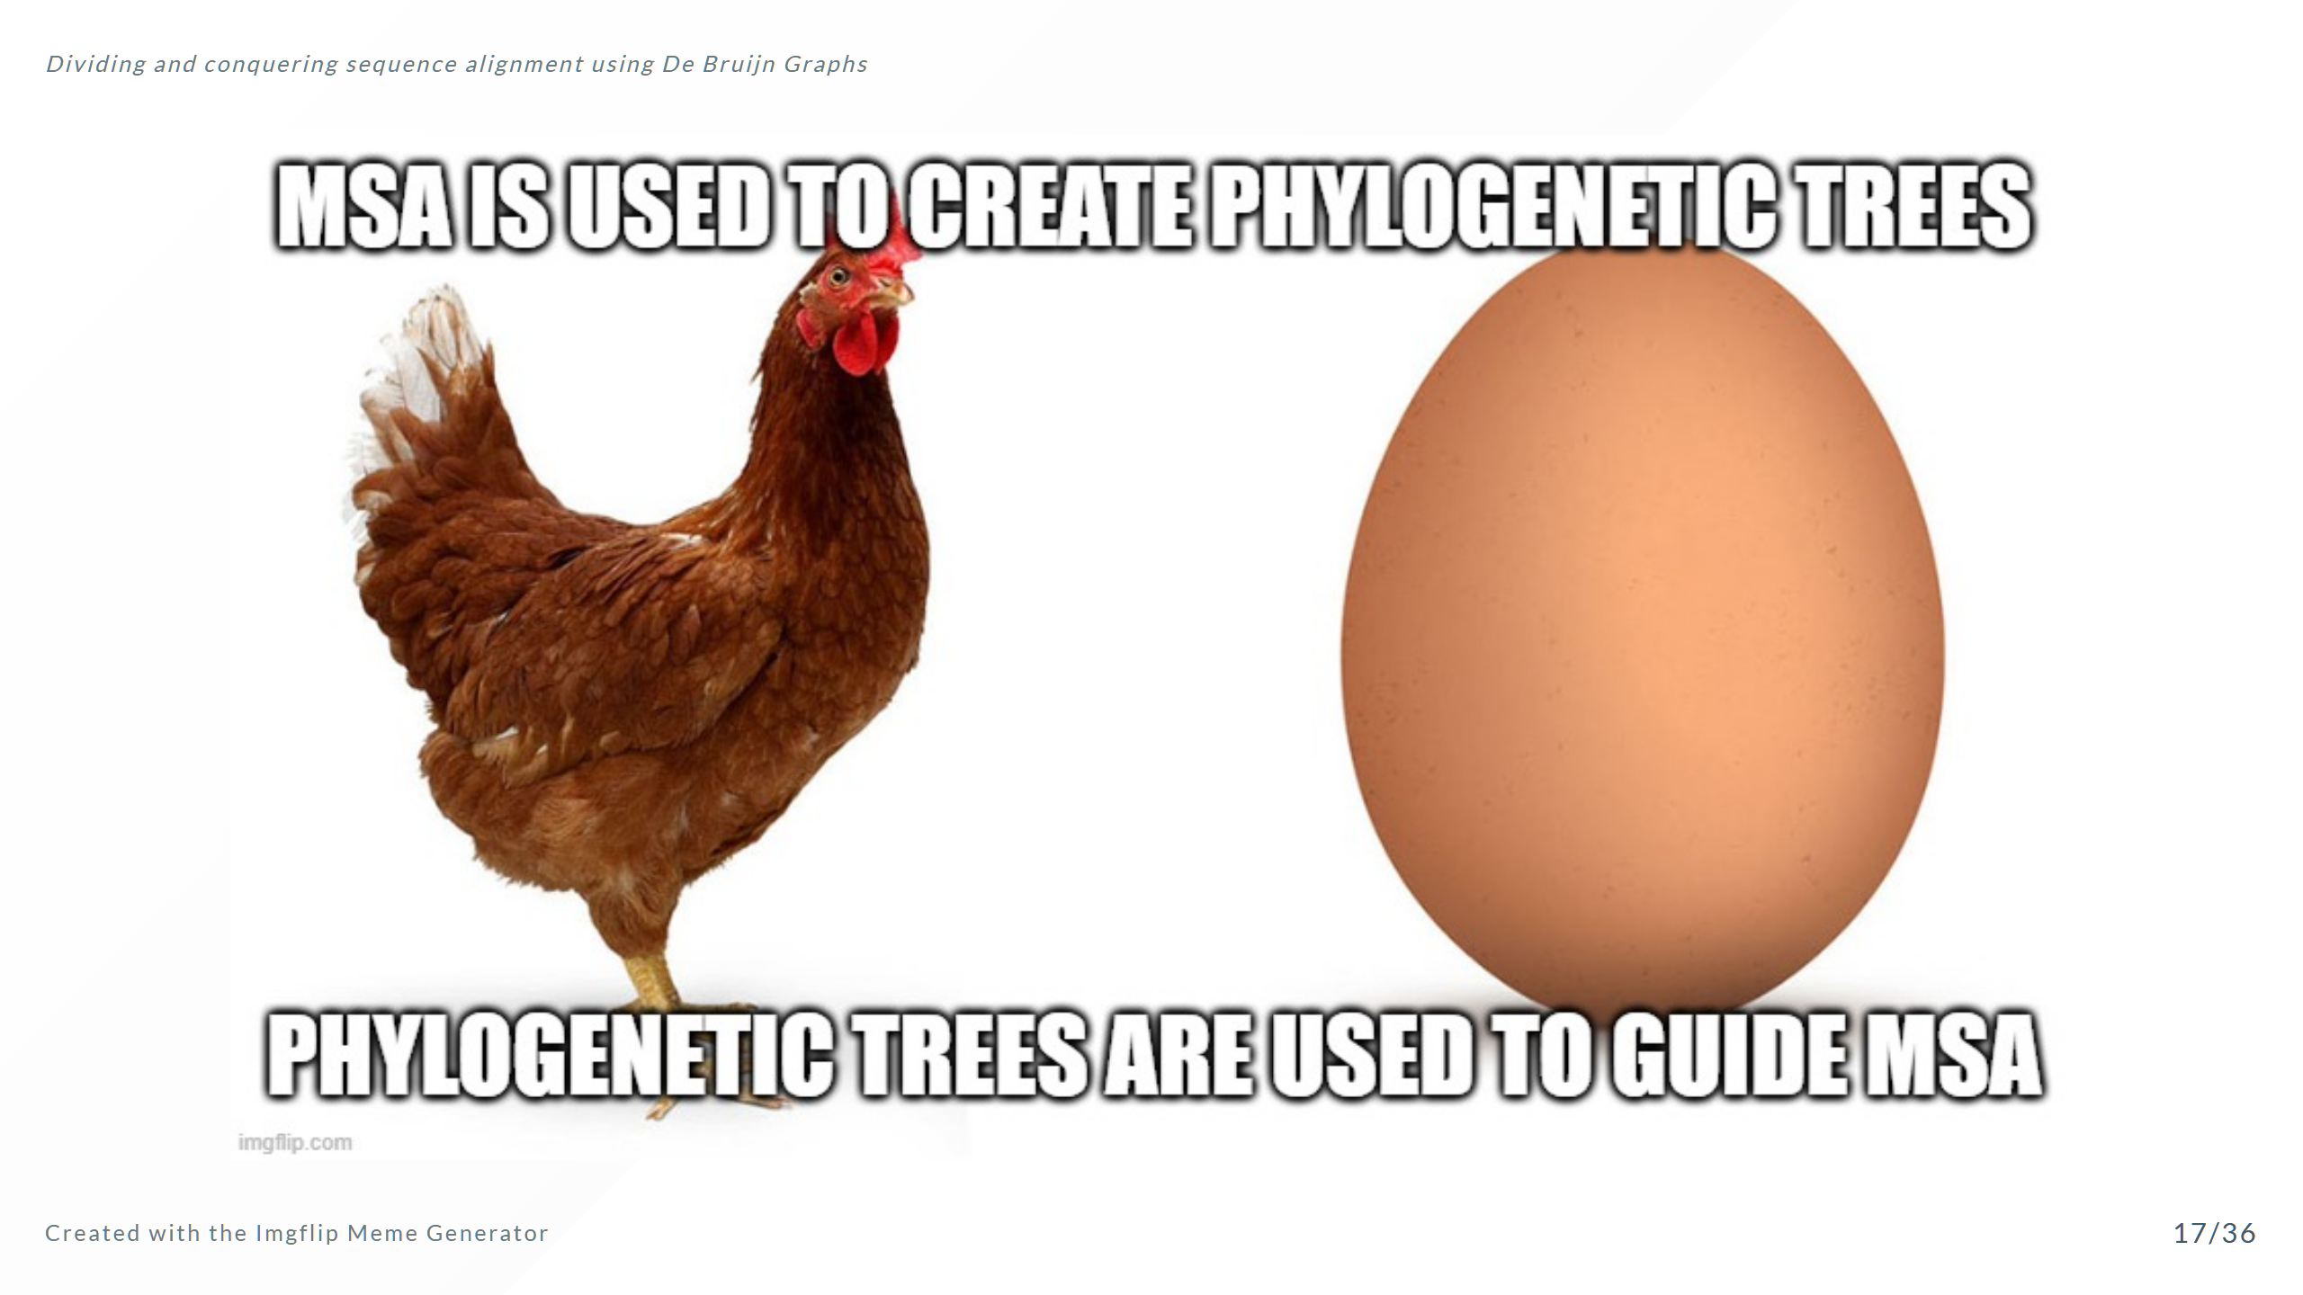

Slide 32
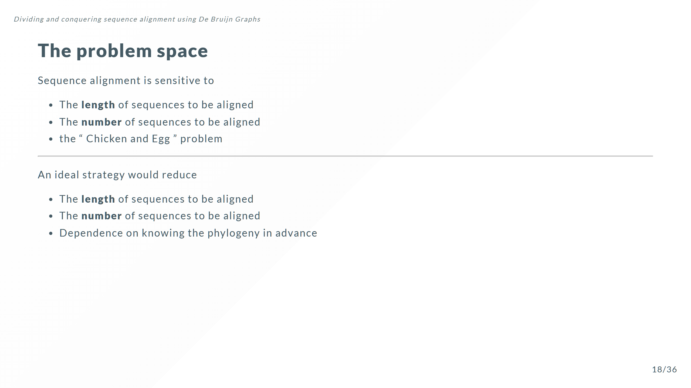

Slide 33
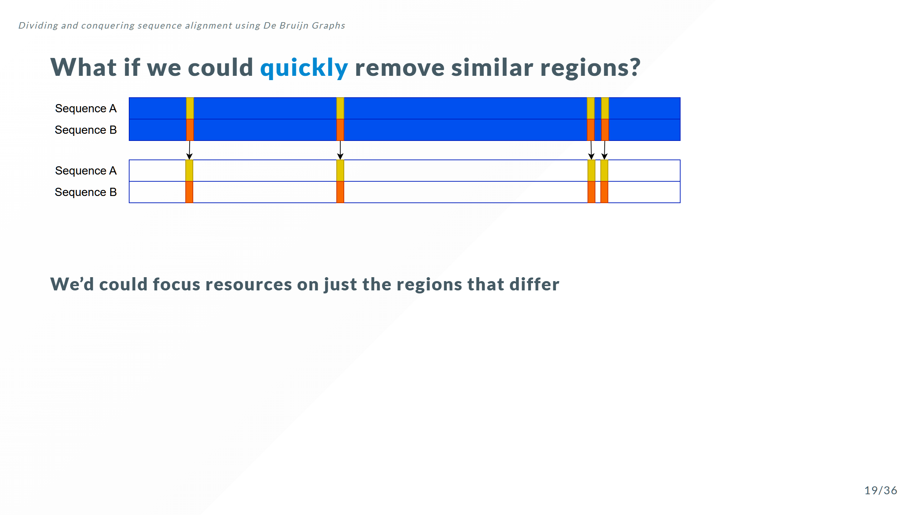

Slide 34
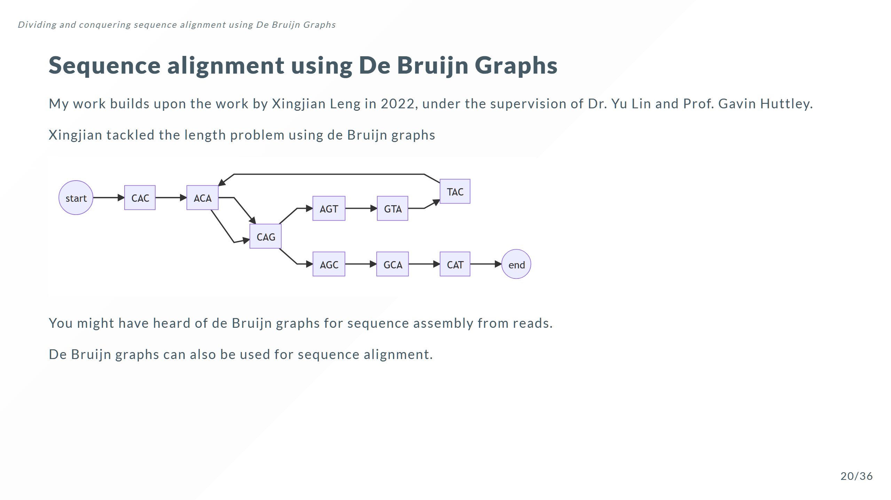

Slide 35
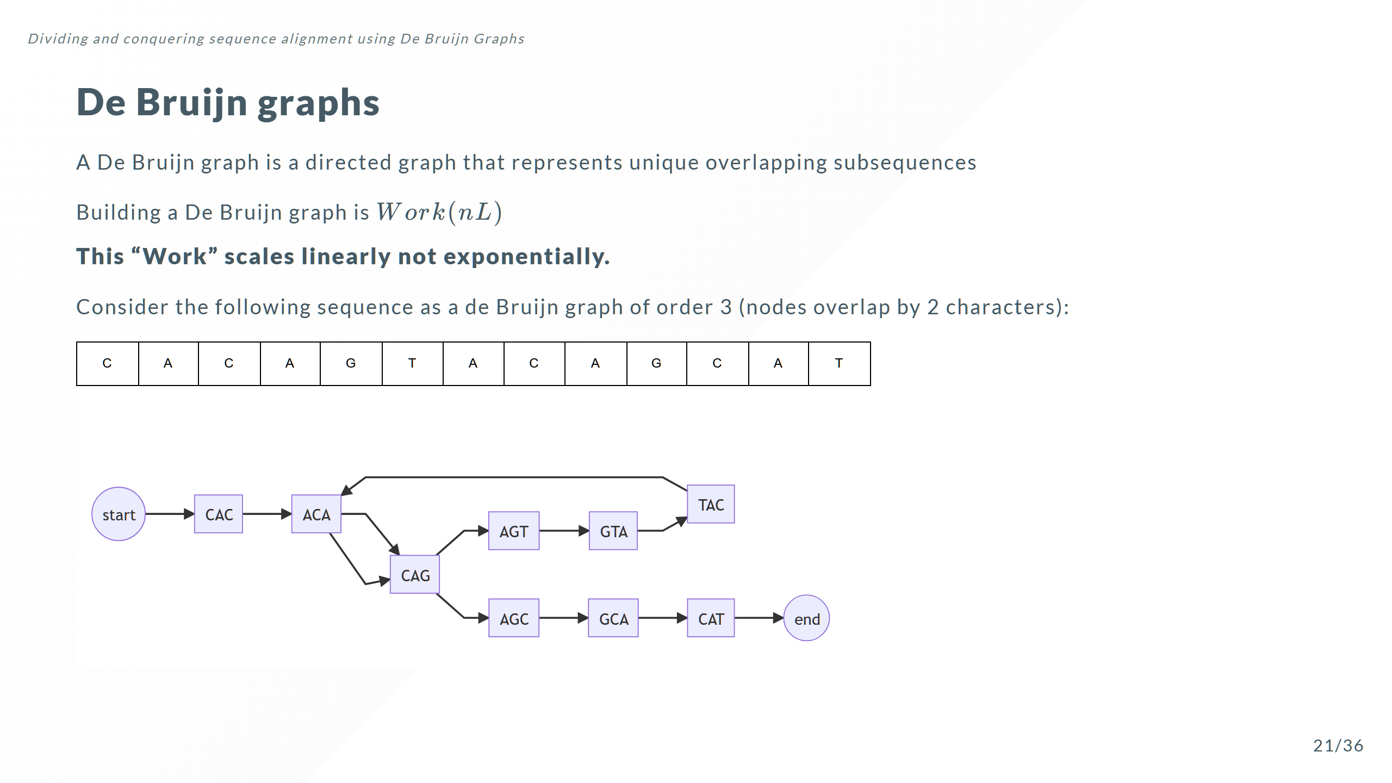

Slide 36
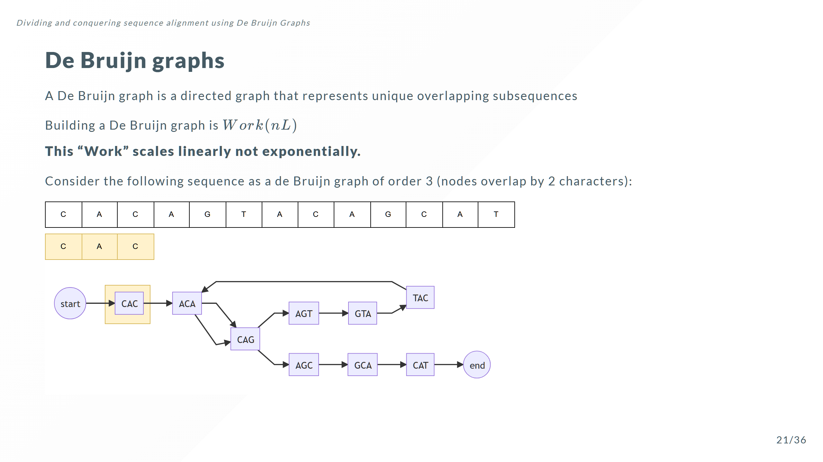

Slide 37
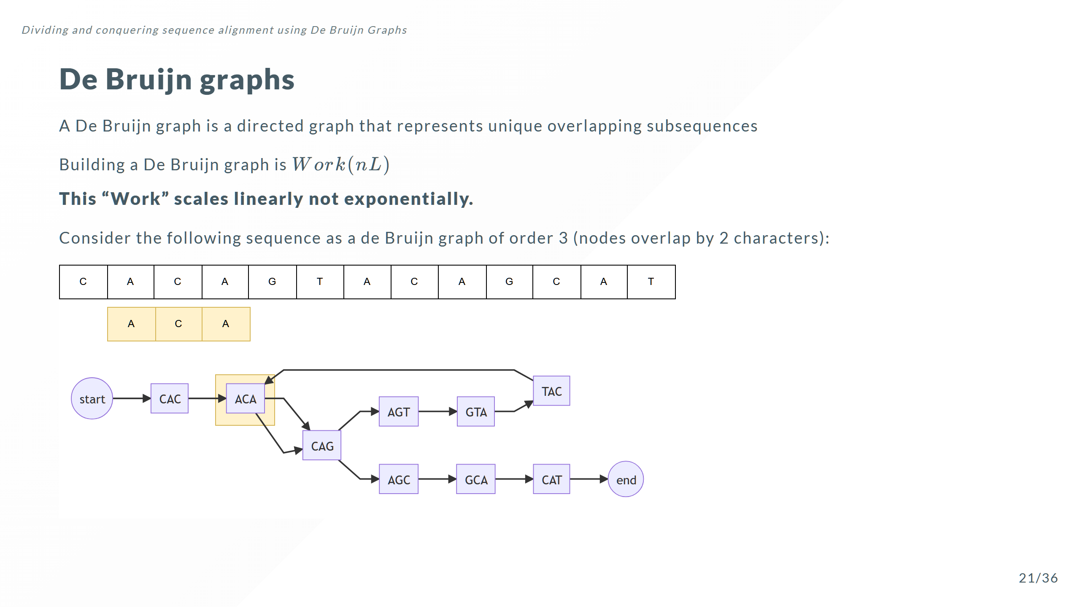

Slide 38
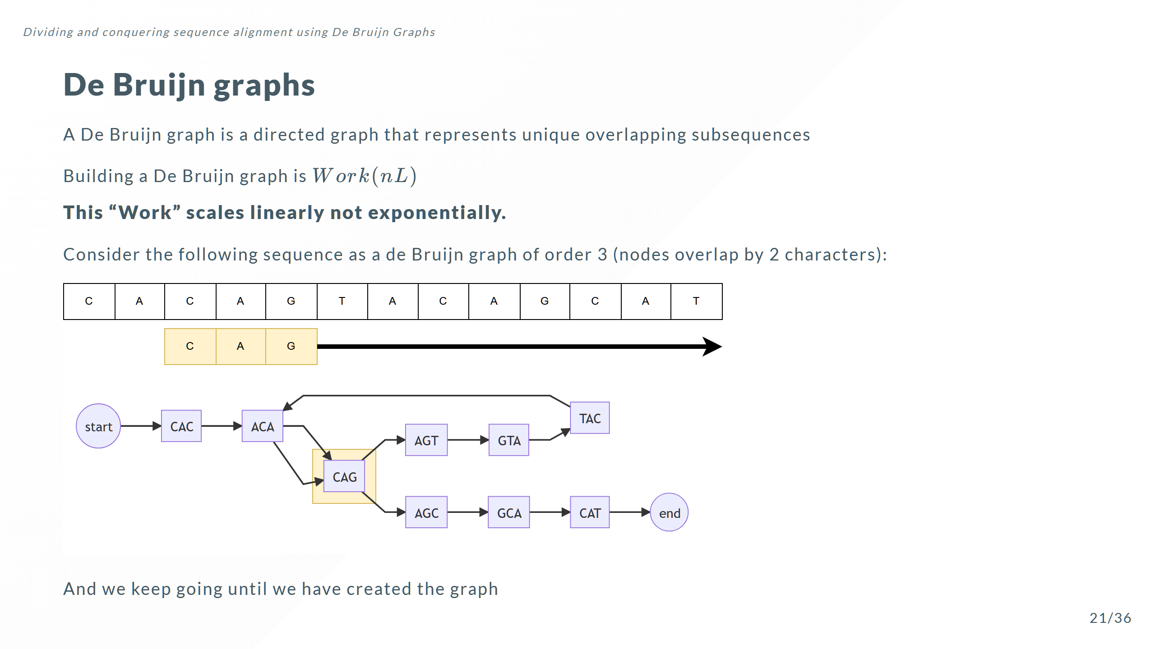

Slide 39
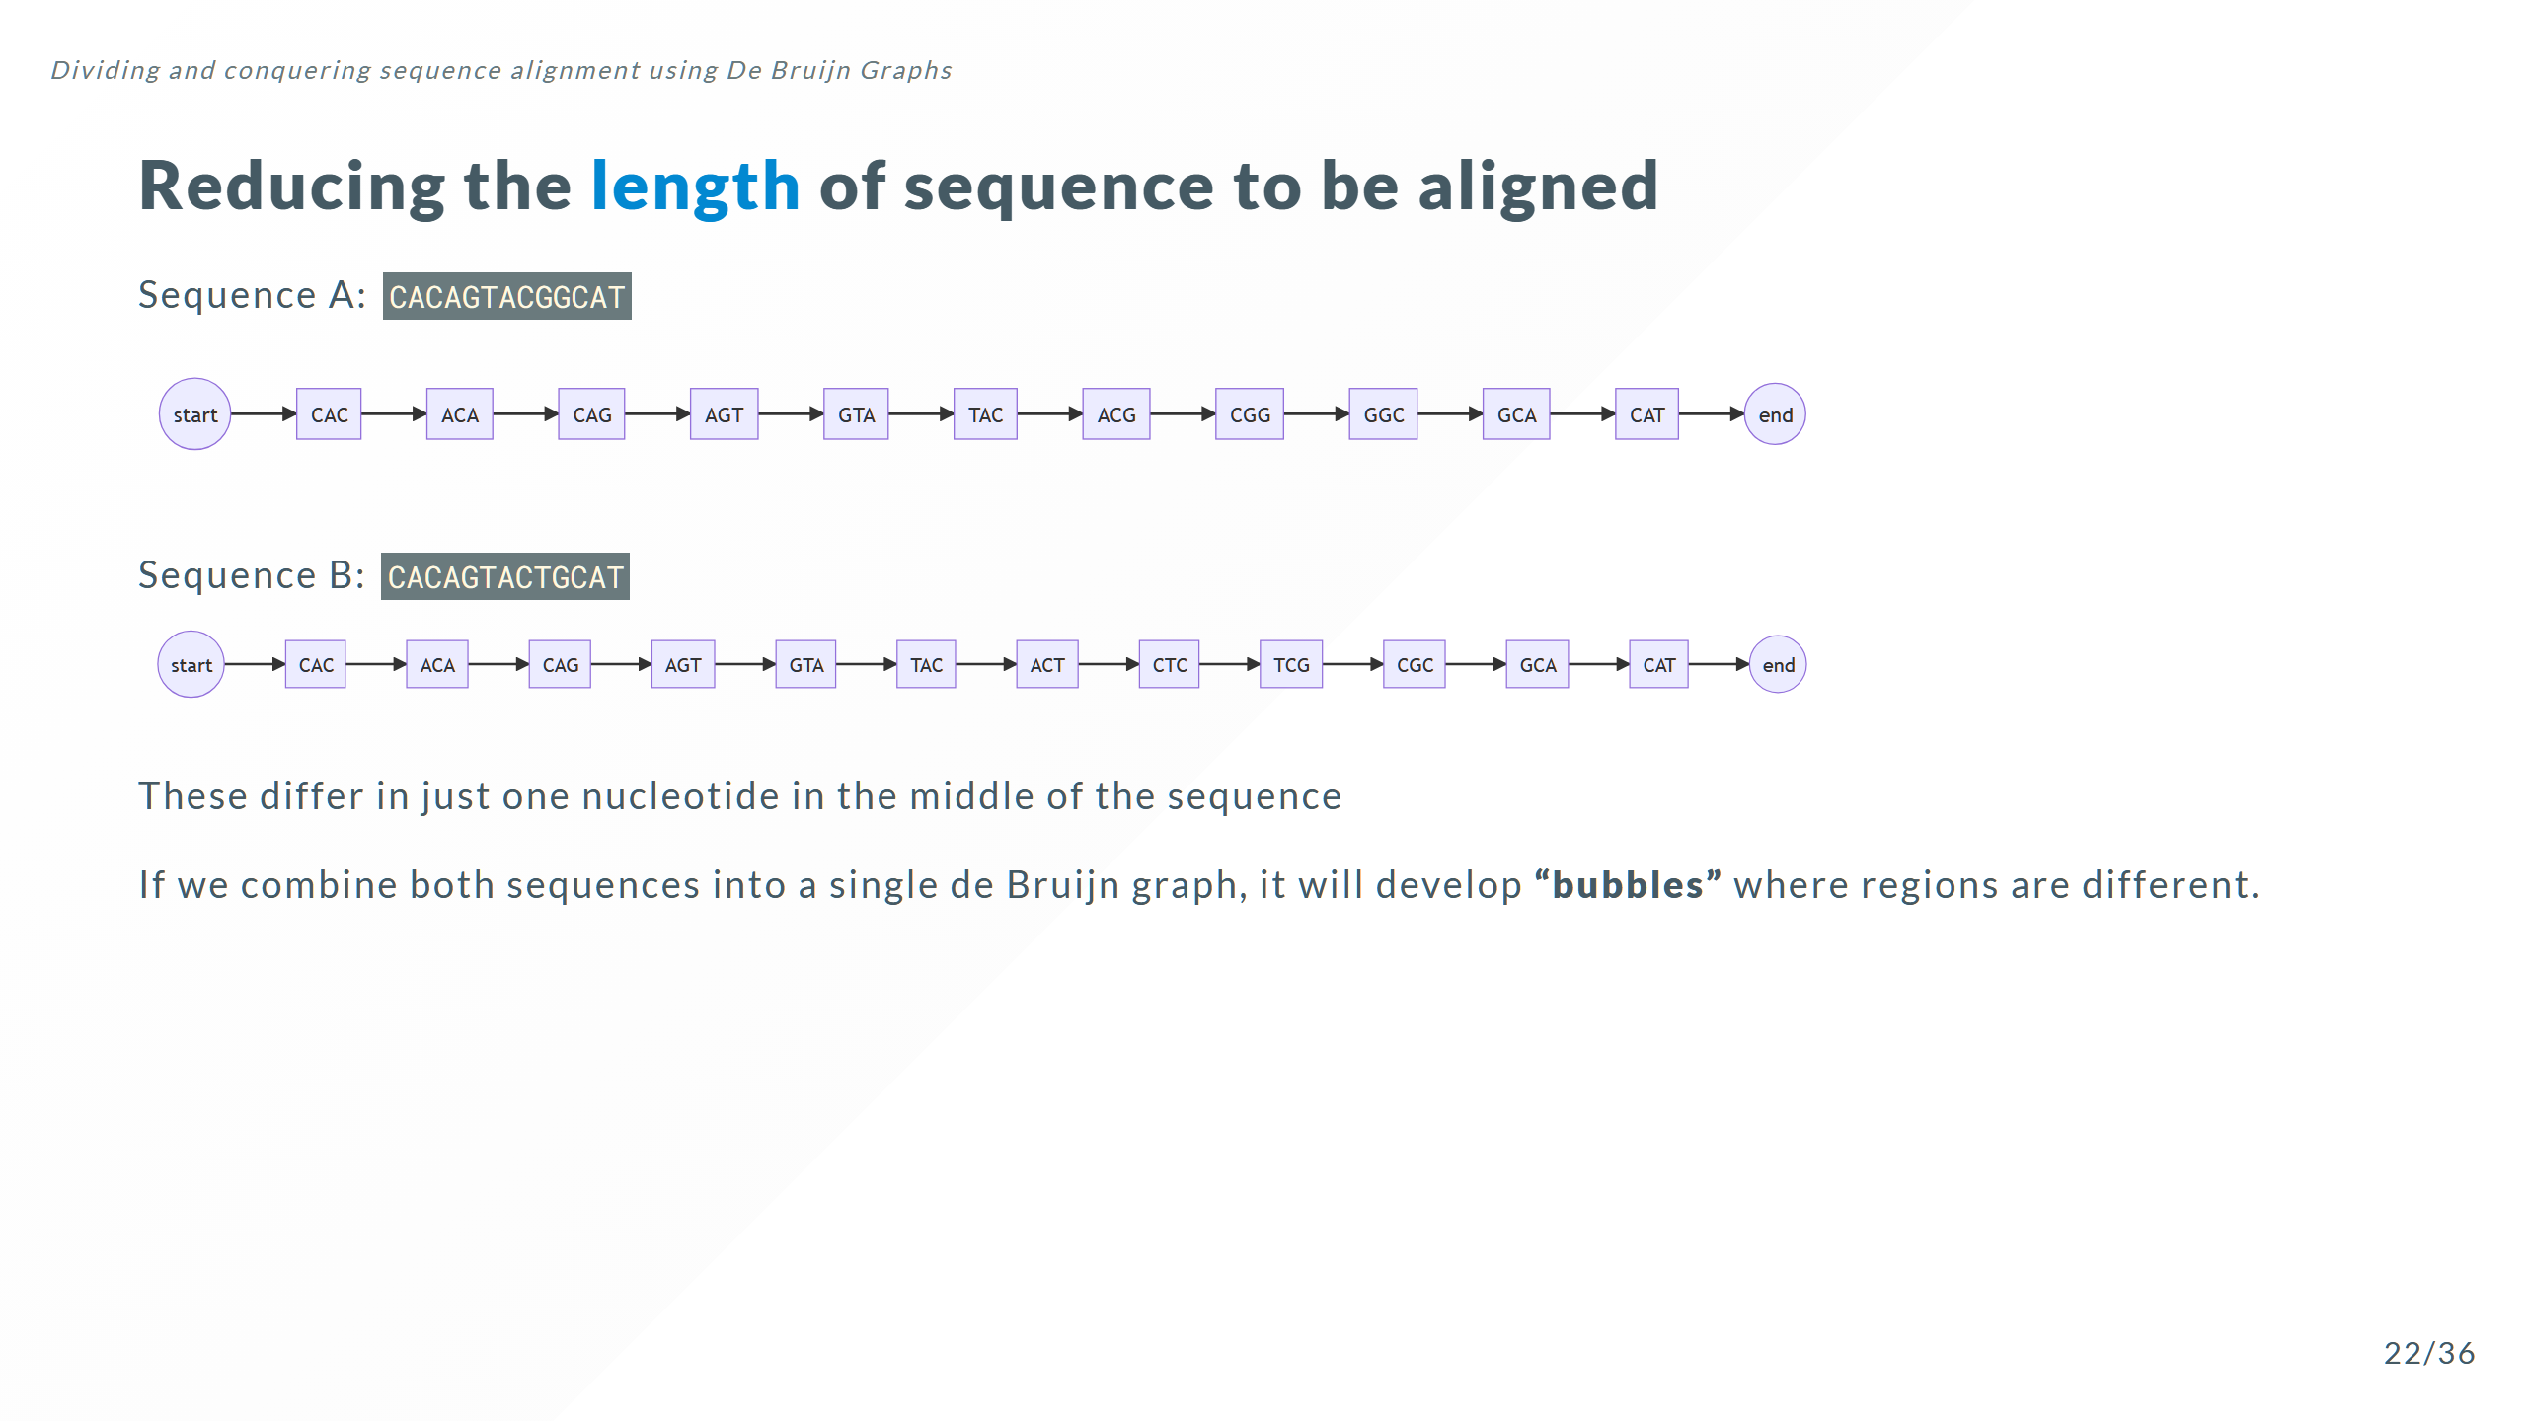

Slide 40
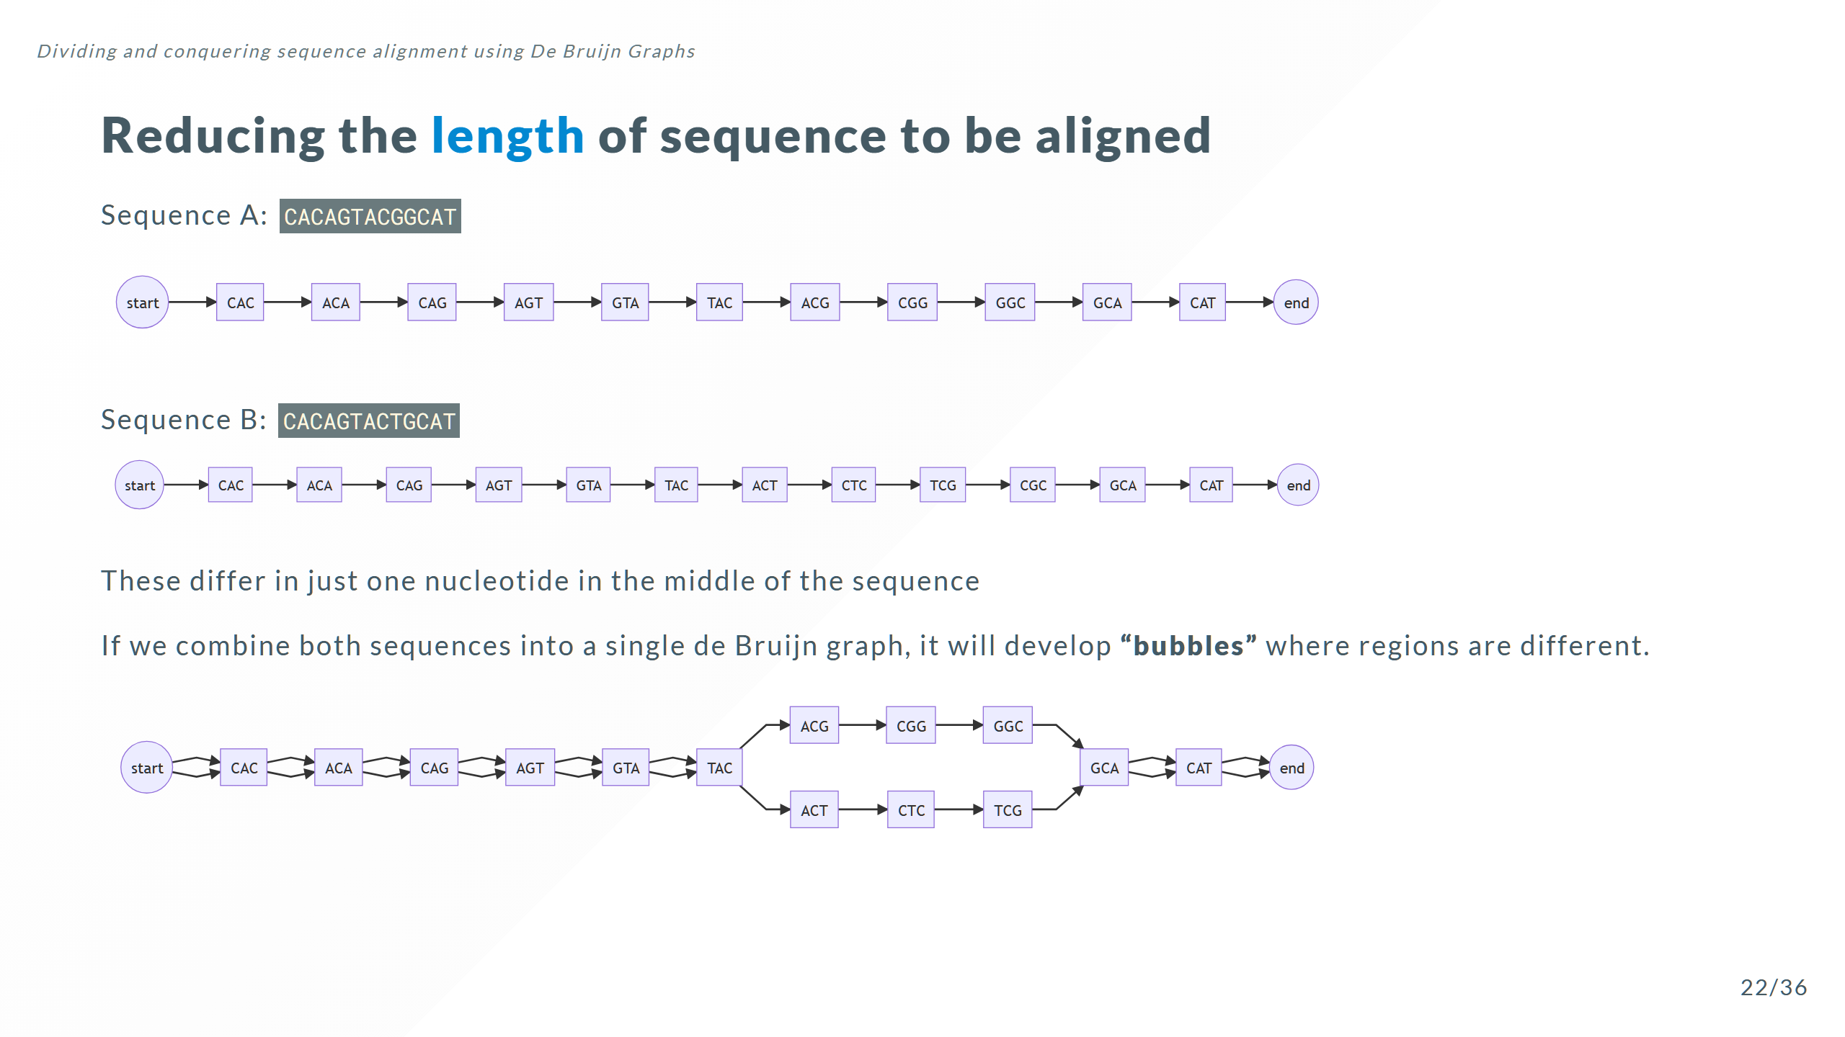

Slide 41
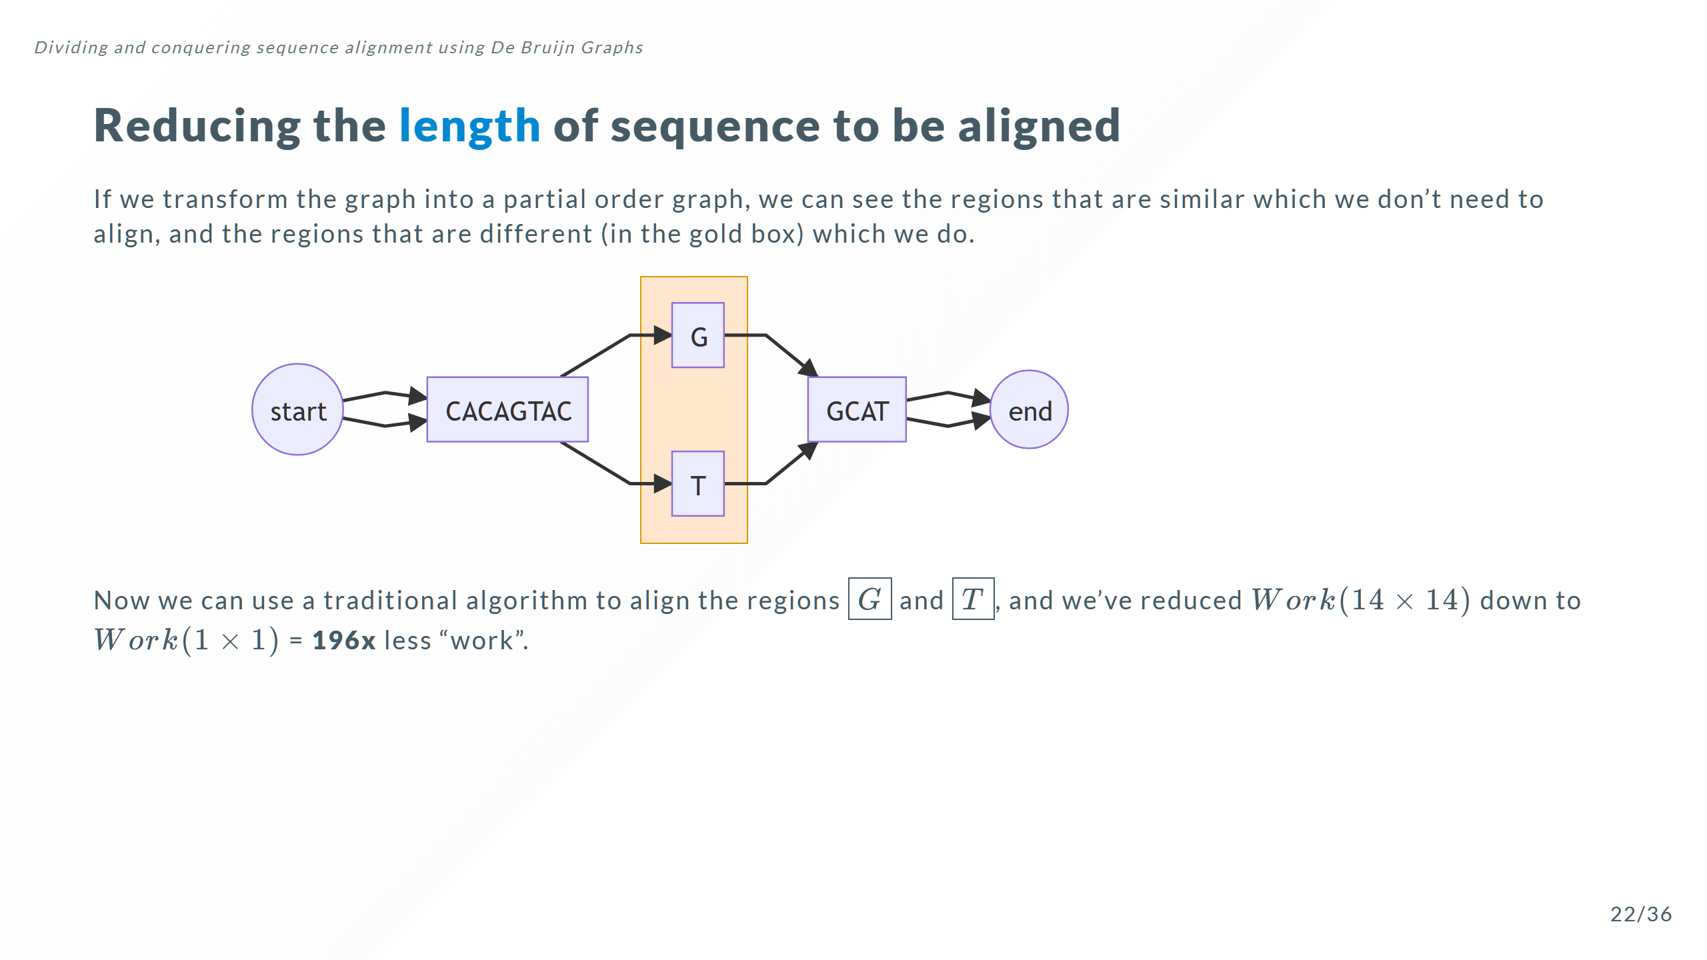

Slide 42
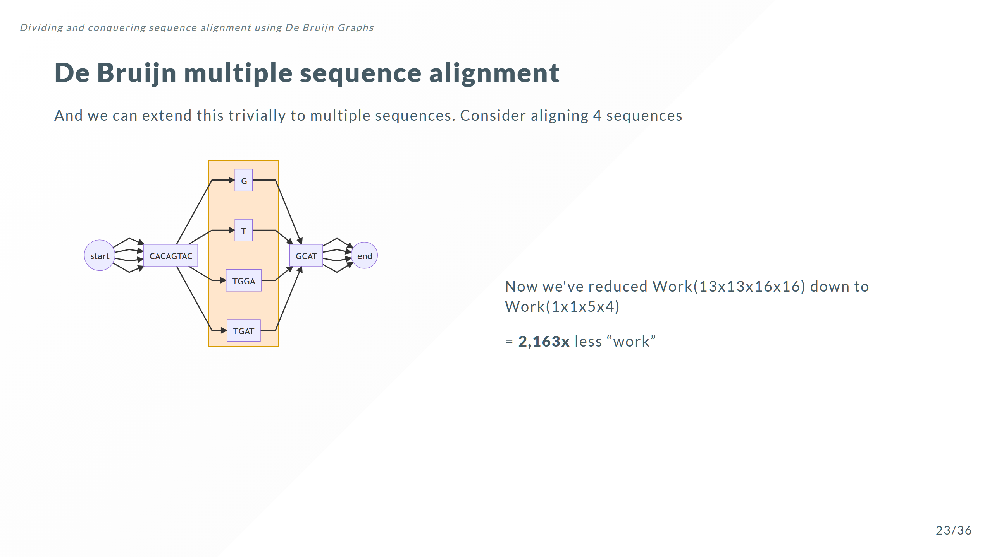

Slide 43
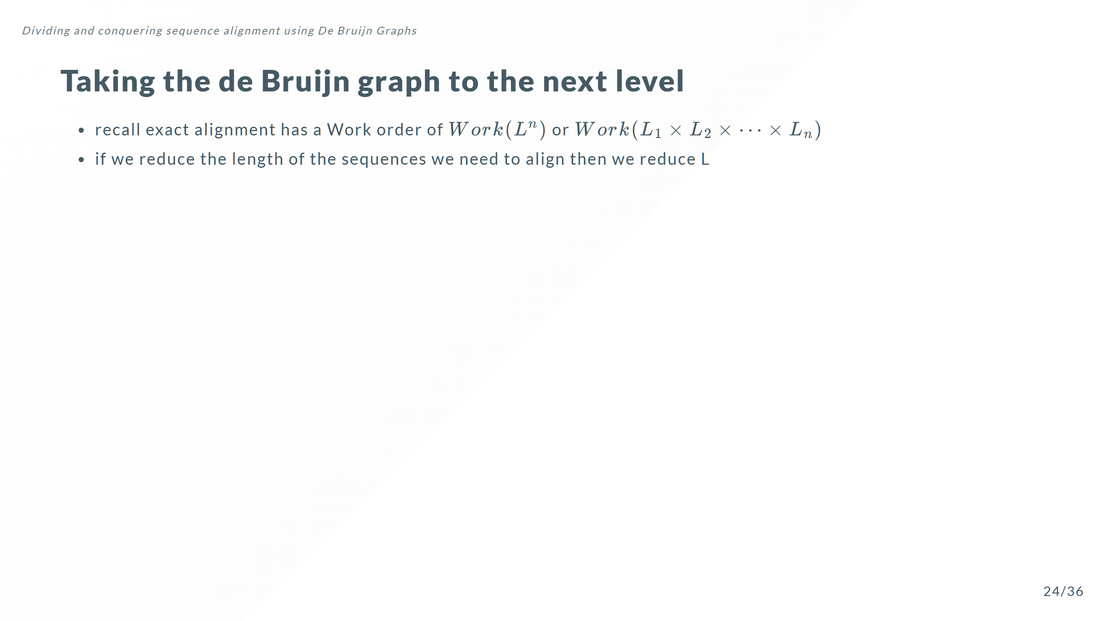

Slide 44
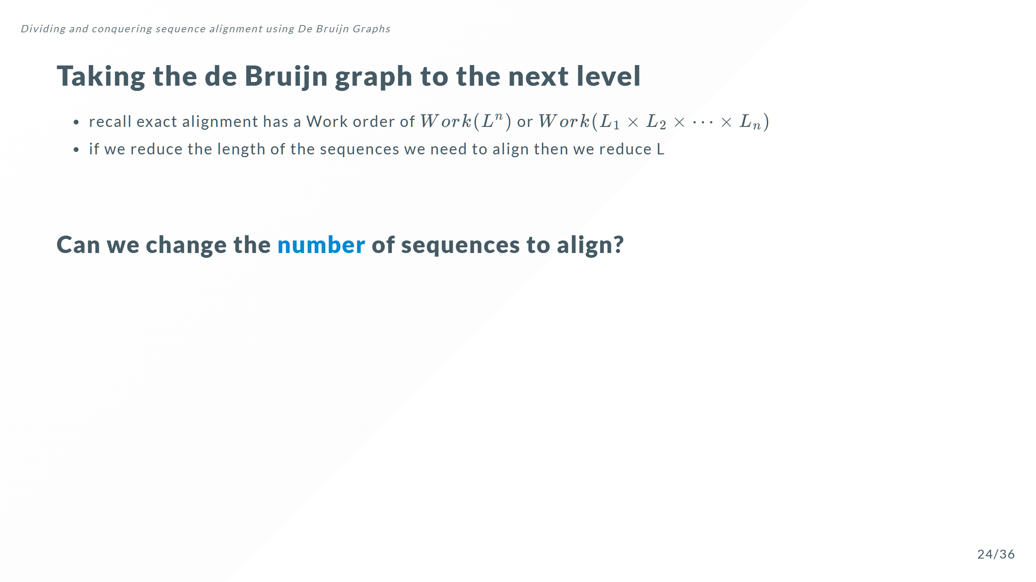

Slide 45
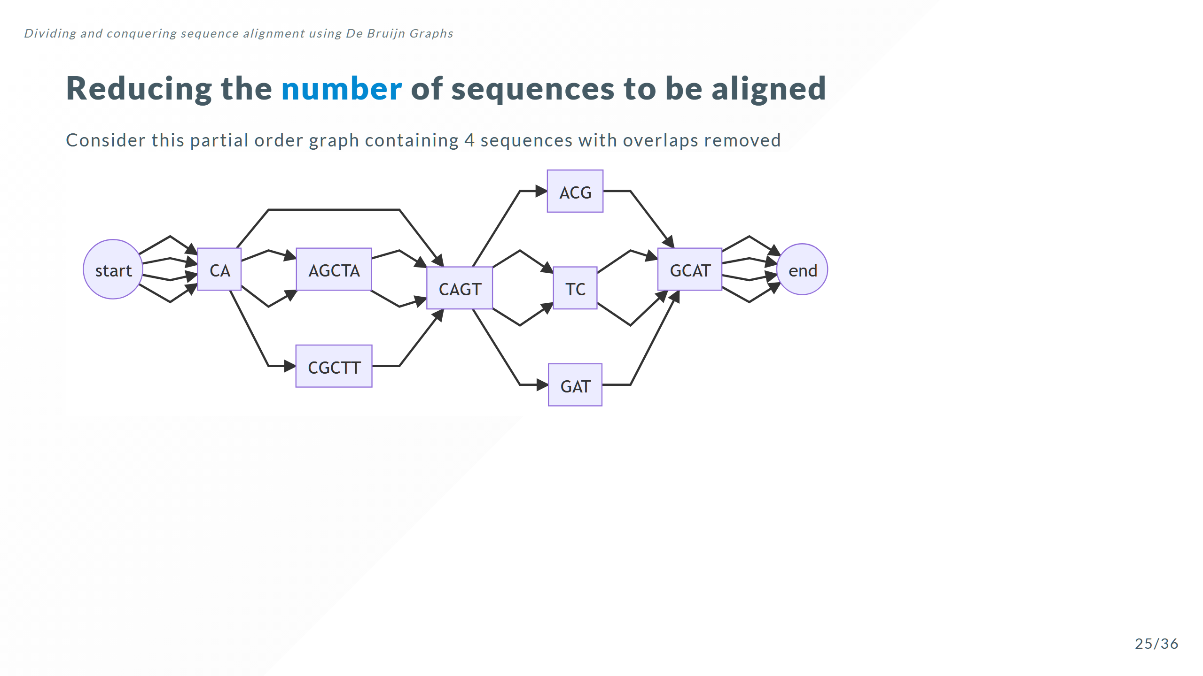

Slide 46
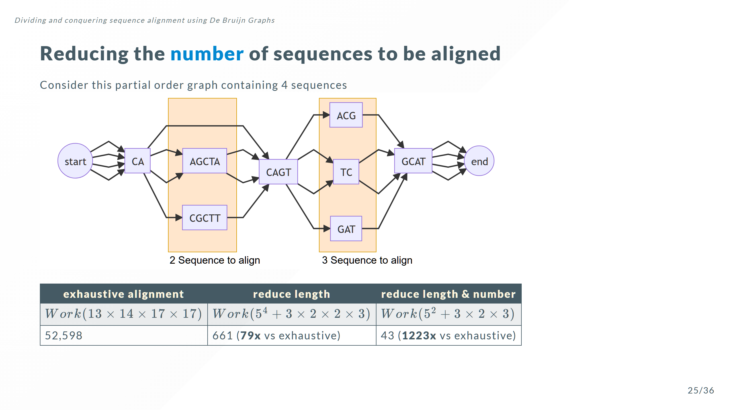

Slide 47
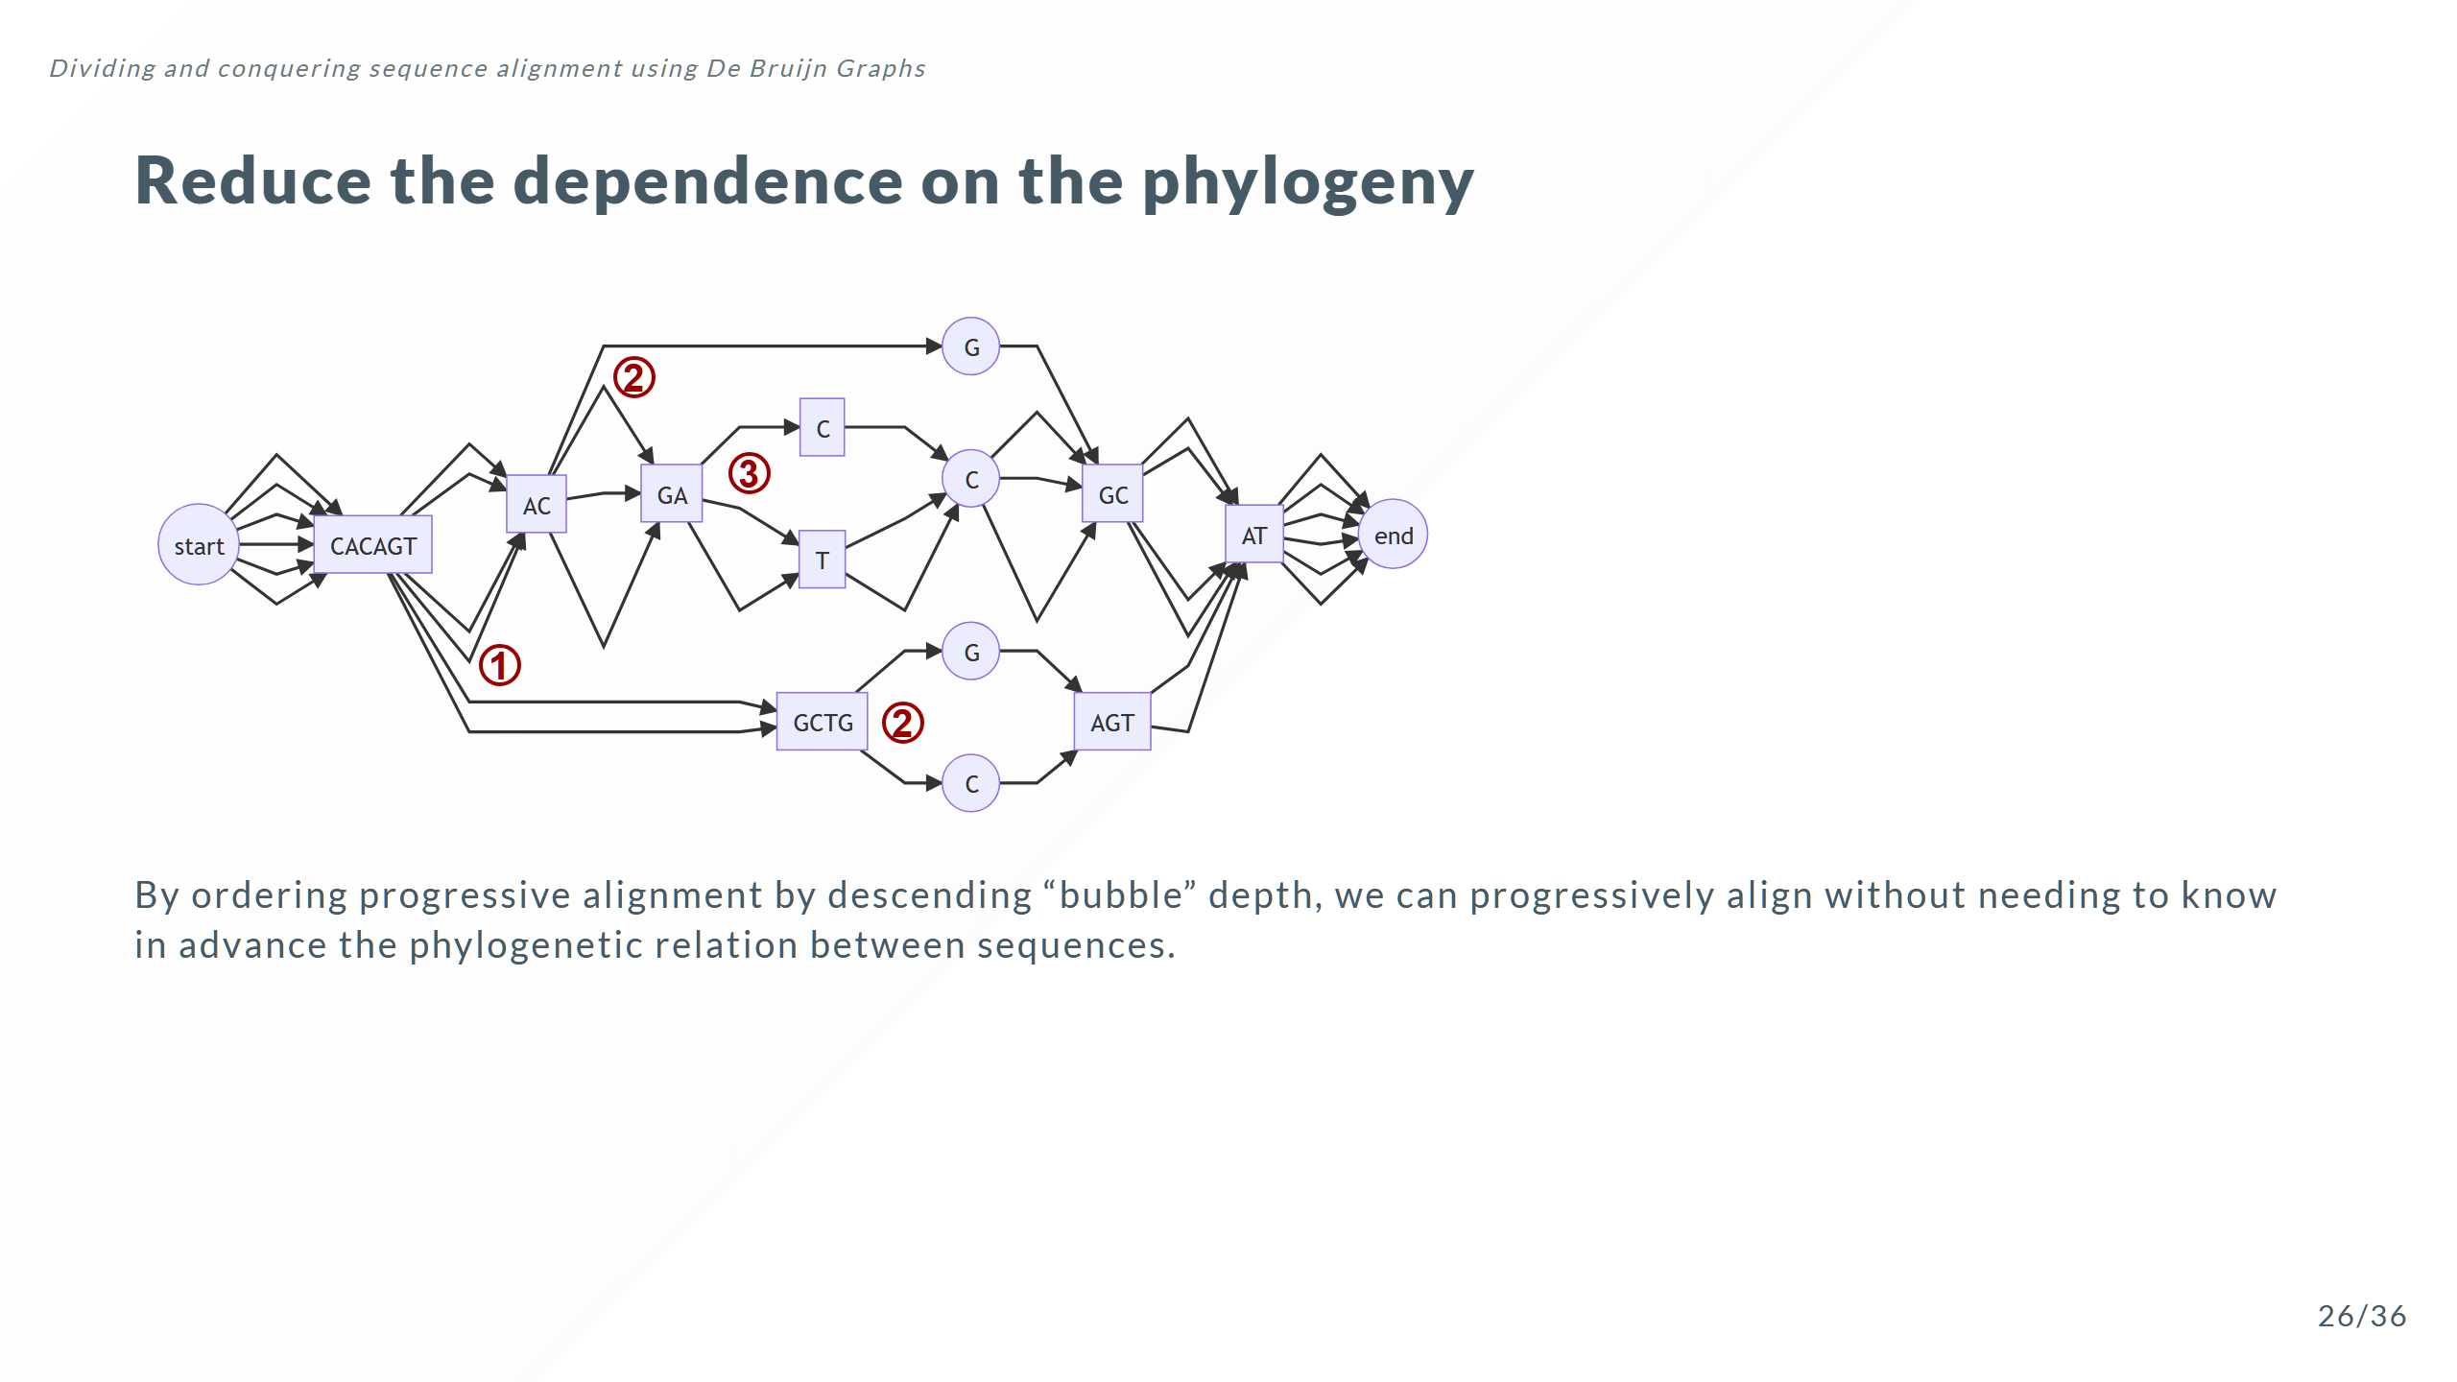

Slide 48
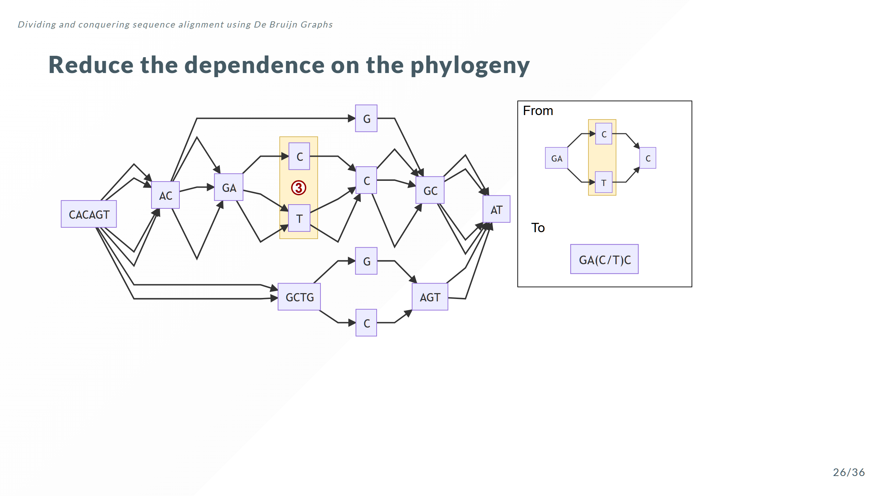

Slide 49
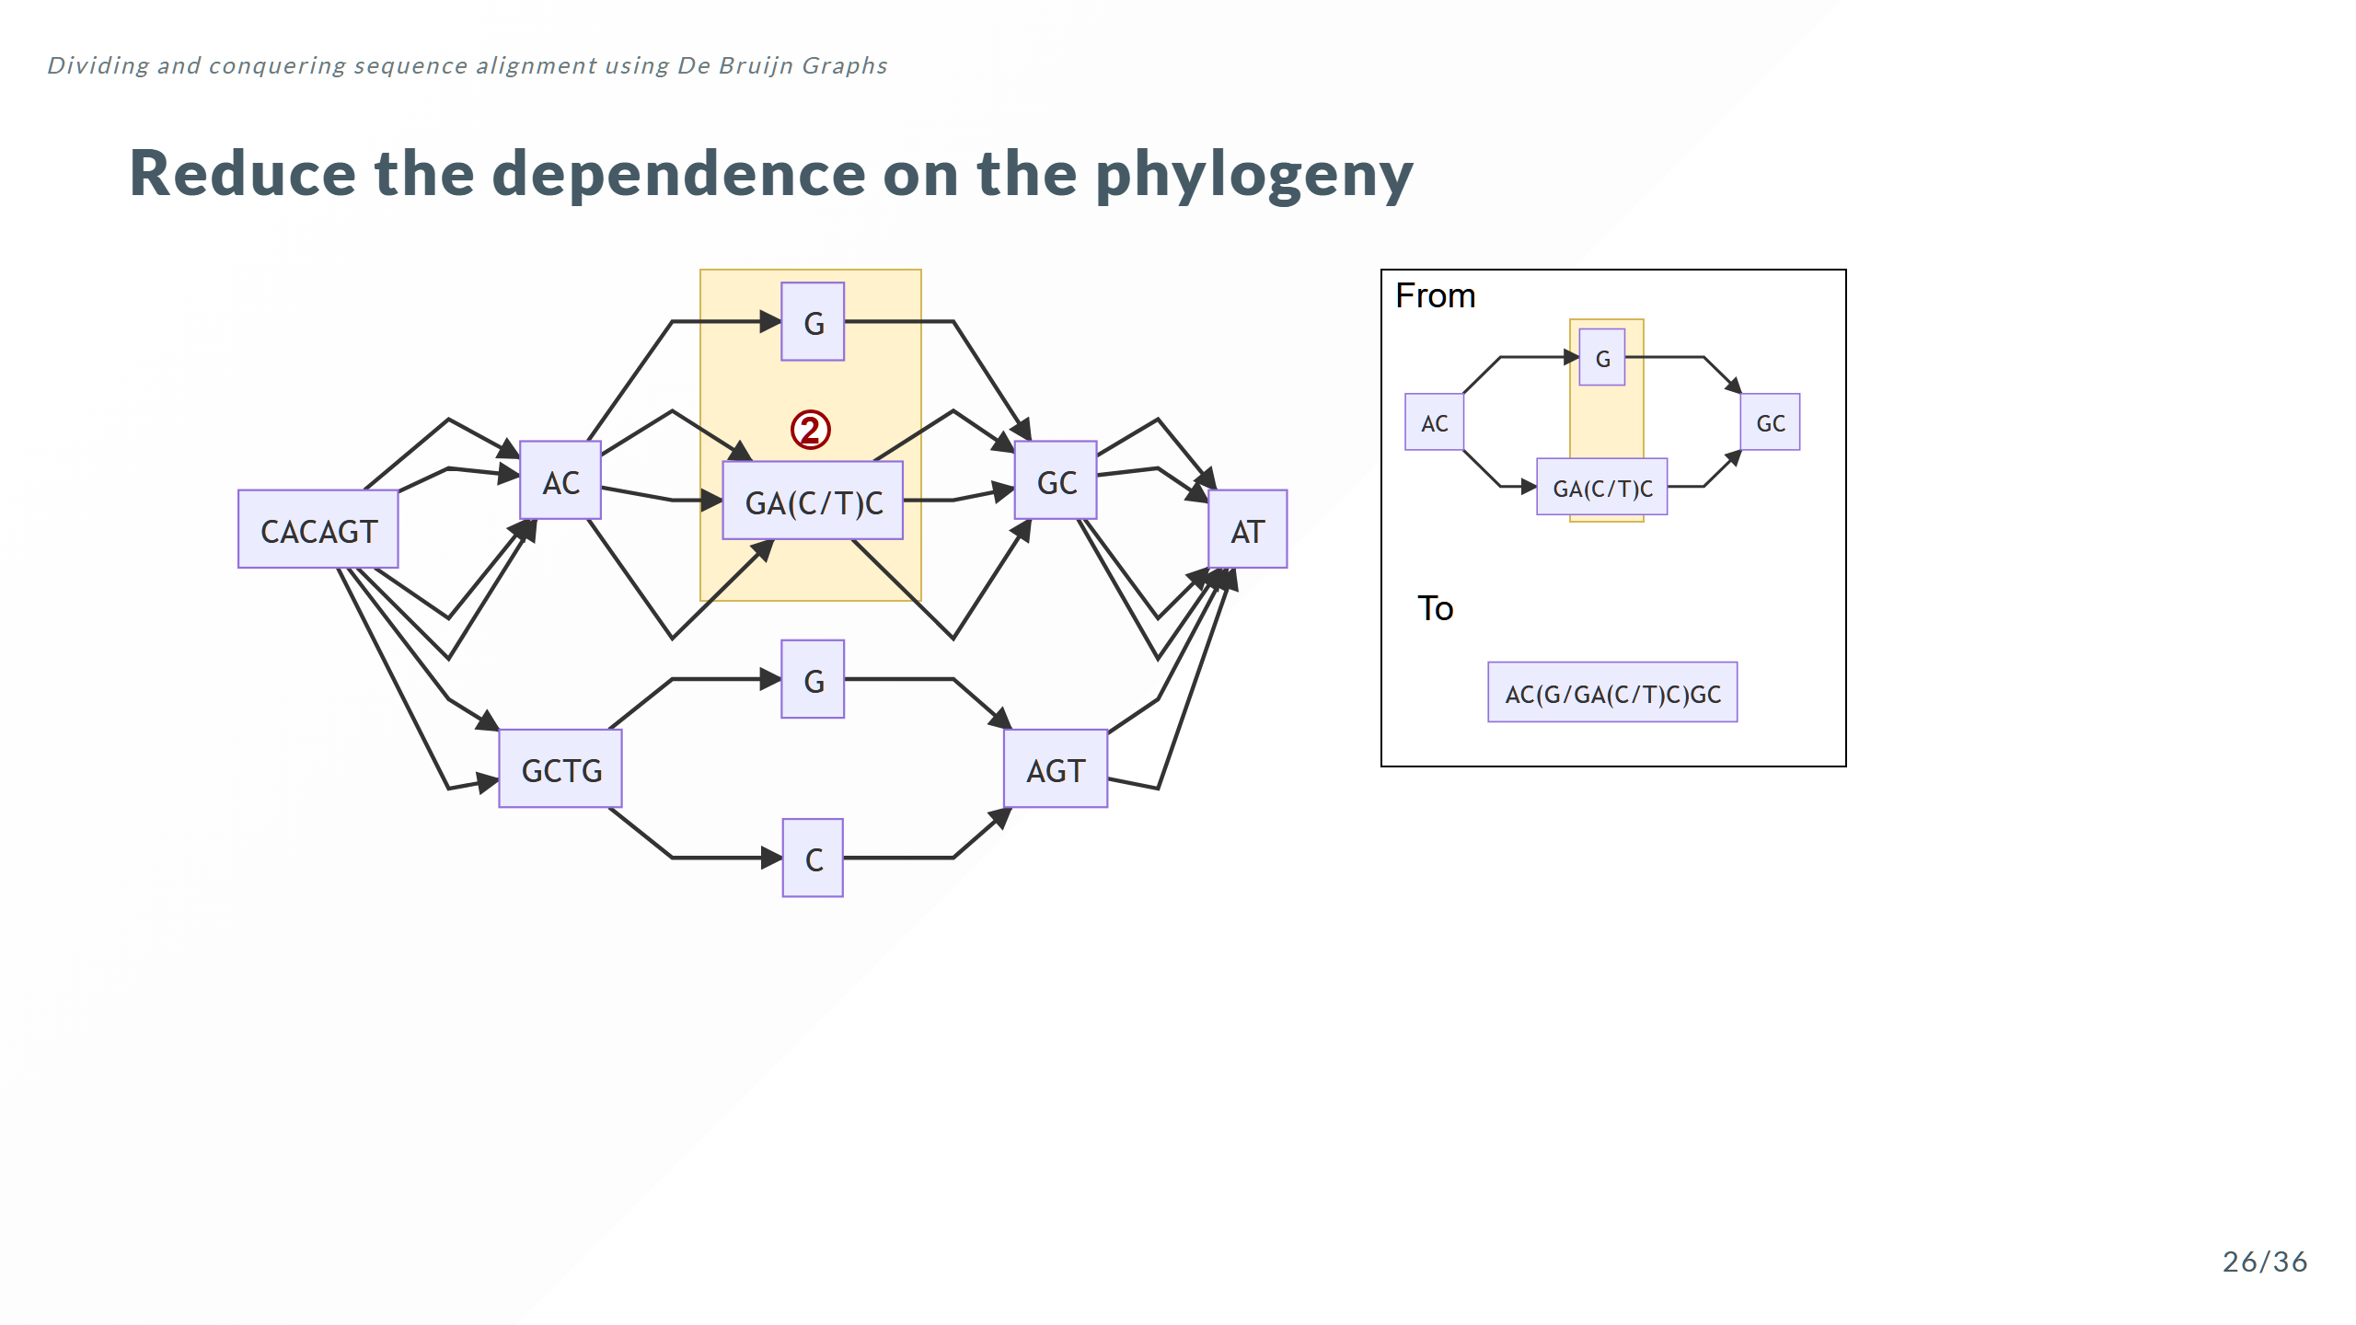

Slide 50
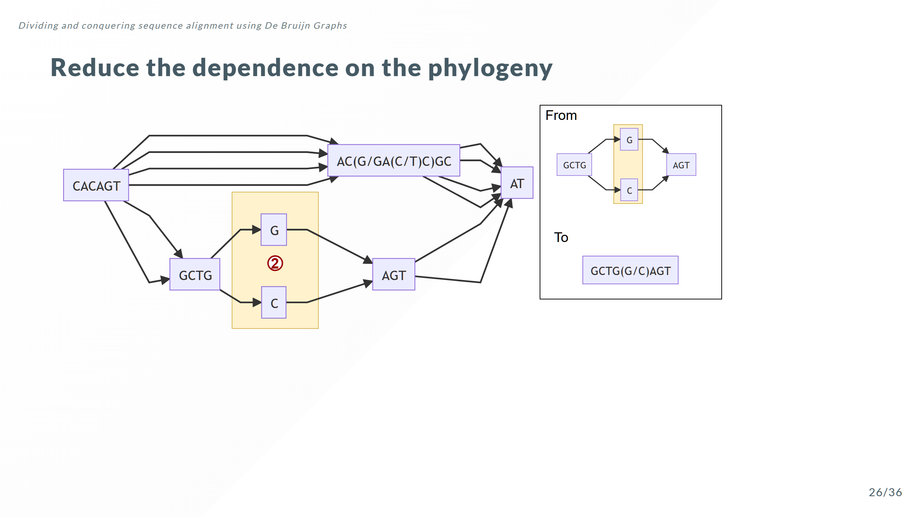

Slide 51
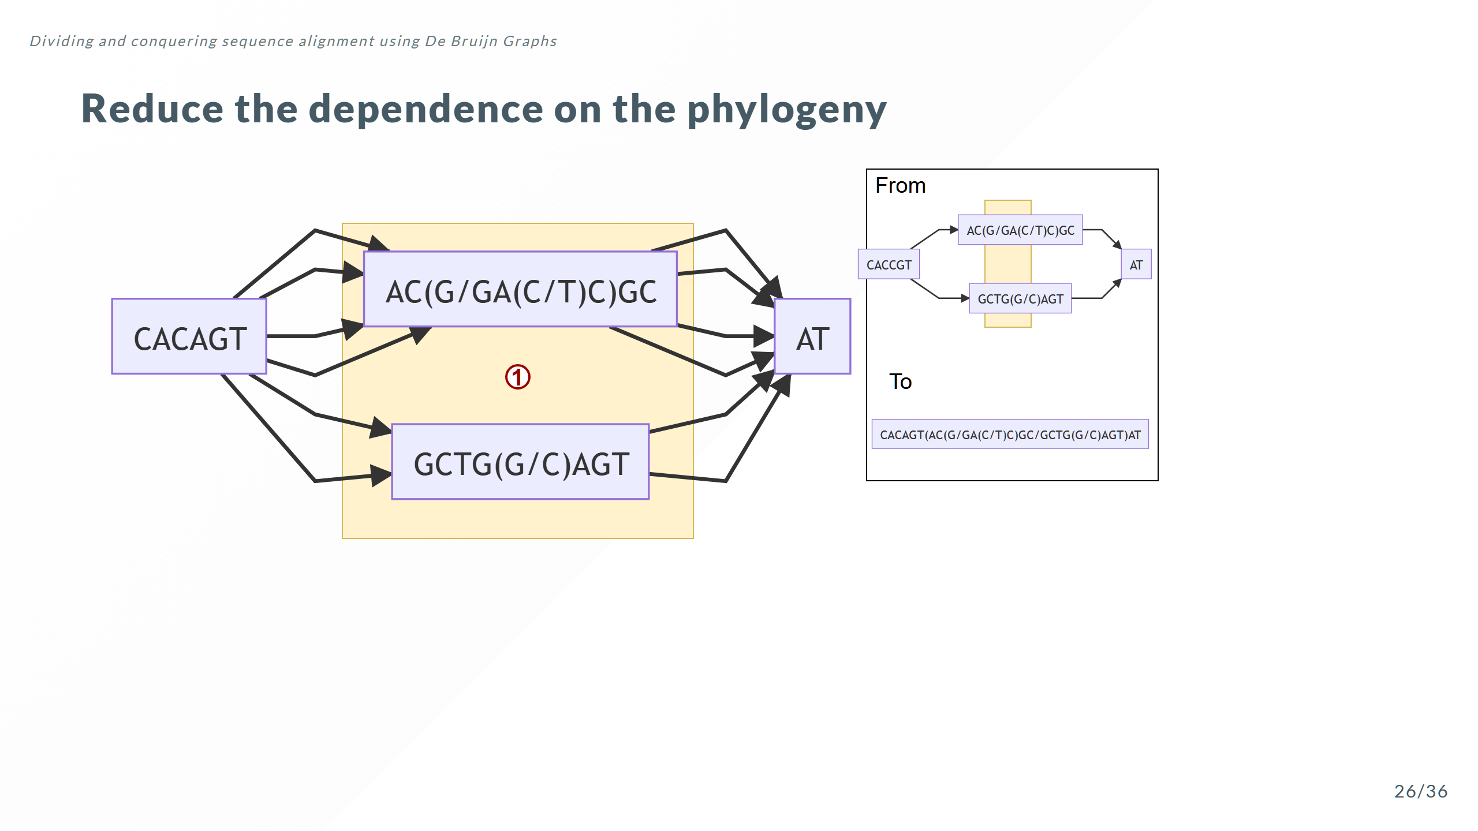

Slide 52
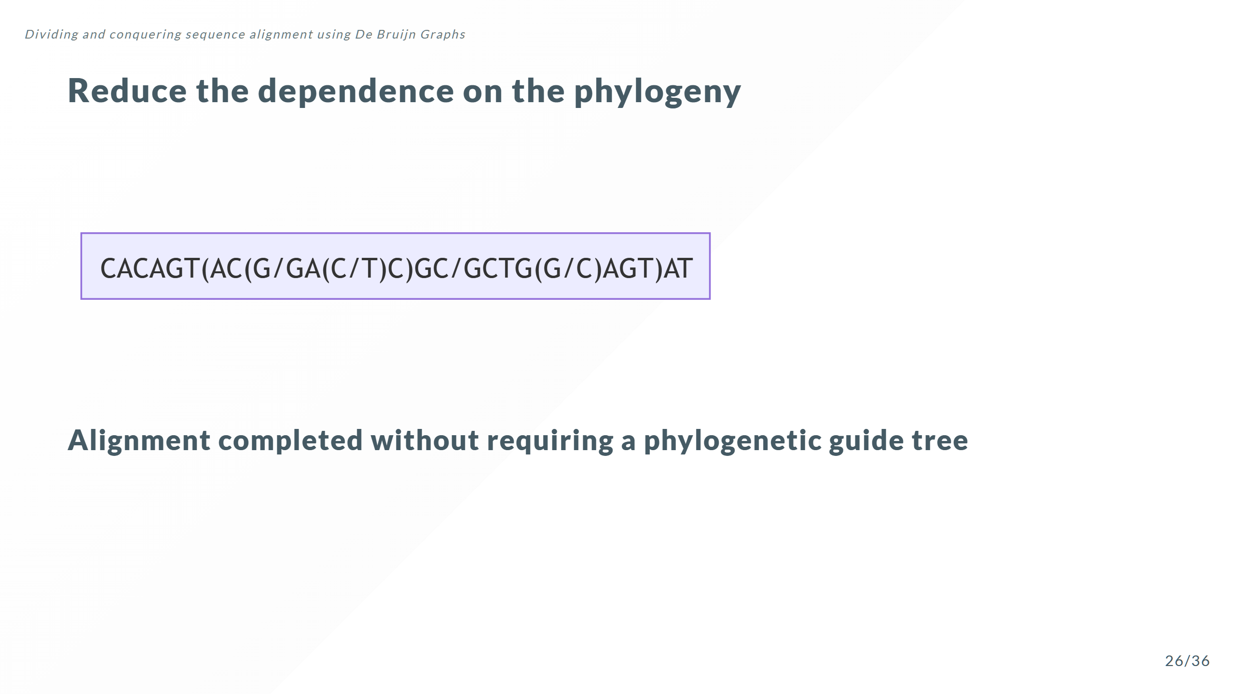

Slide 53


Slide 54


Slide 55

Notes:
Why is DBG_LN() different from Quickwork() Quickwork() does not take into account how the distribution of differences affects the work or how zero length edges affect the work

Slide 56


Slide 57


Slide 58


Slide 59


Slide 60


Slide 61


Slide 62


Slide 63


Slide 64


Slide 65

Notes:
The pairwise algorithms are both actually O(mn) where m and n are the lengths of the 2 sequences.

Slide 66


Slide 67


Slide 68


